Slide 1
Getting started with Spring Boot
Pre-Training for Cloud Native Workshop
Toshiaki Maki
Feb 8 2016

Slide 2
Contents
HelloWorld (1.5h)
Web (1h)
DataAccess (1.5h)
Actuator (0.5h)

Slide 3
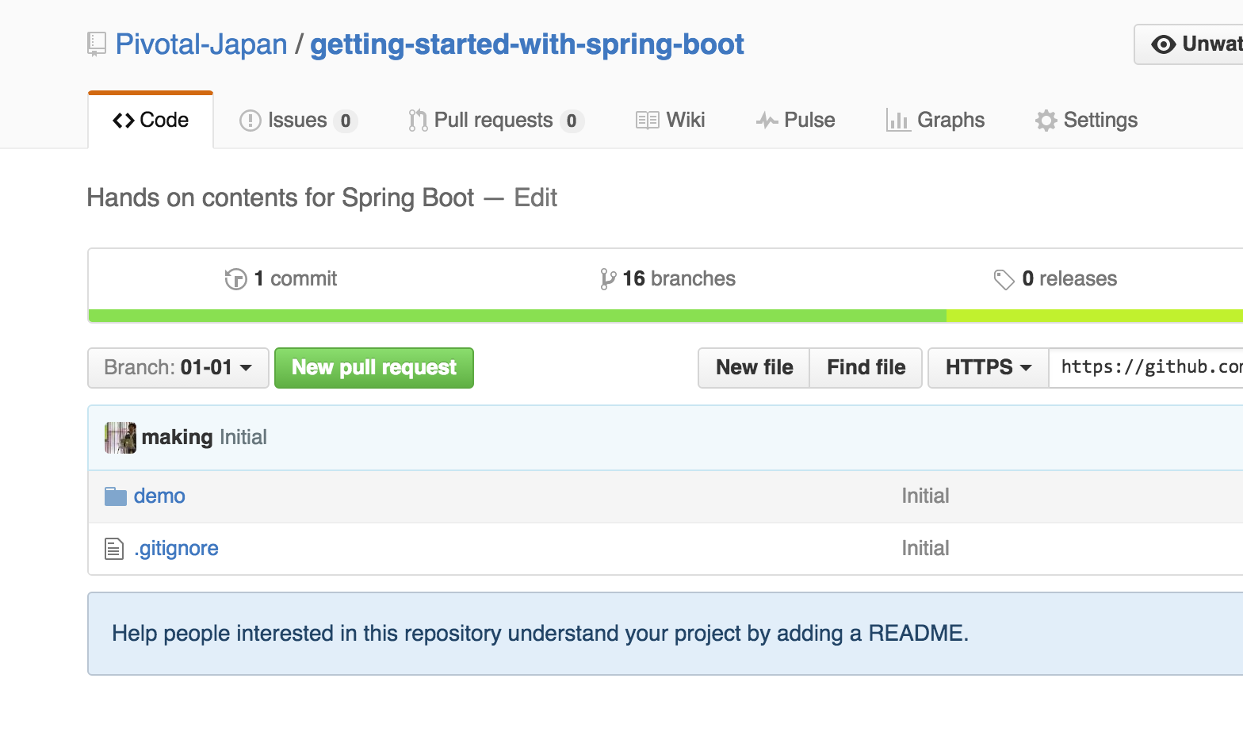
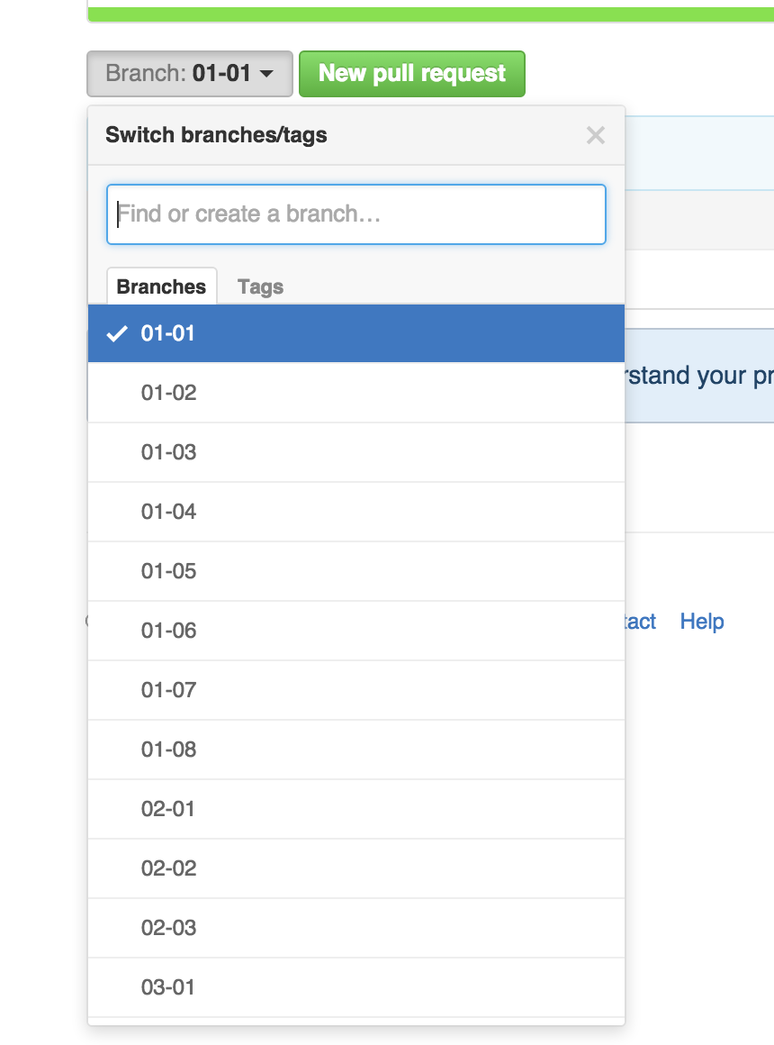
Source Code
https://github.com/Pivotal-Japan/getting-started-with-spring-boot

Slide 4
Spring Framework
Spring is a Java framework for enterprise applications, supports
dependency injection
transaction management
web applications
data access
messaging
testing and more.

Slide 5
Spring Boot
Spring Boot makes it easy to create stand-alone, production-grade Spring based Applications that you can "just run".

Slide 6
Spring Boot
Create stand-alone Spring applications
Embed Tomcat, Jetty or Undertow directly
Provide opinionated 'starter' POMs to simplify your Maven configuration
Automatically configure Spring whenever possible
Provide production-ready features such as metrics, health checks and externalized configuration
Absolutely no code generation and no requirement for XML configuration

Slide 7
Hello World

Slide 8
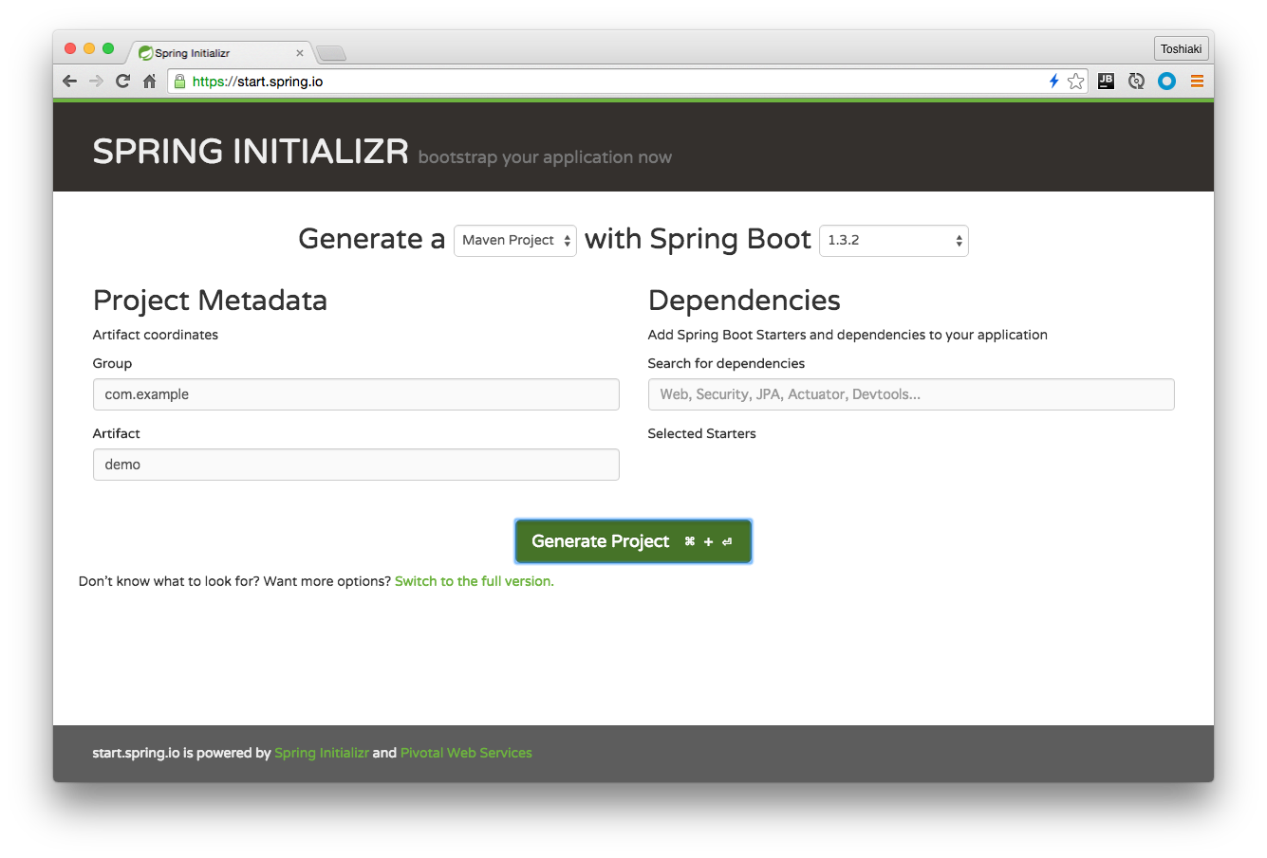
https://start.spring.io
Click

Slide 9
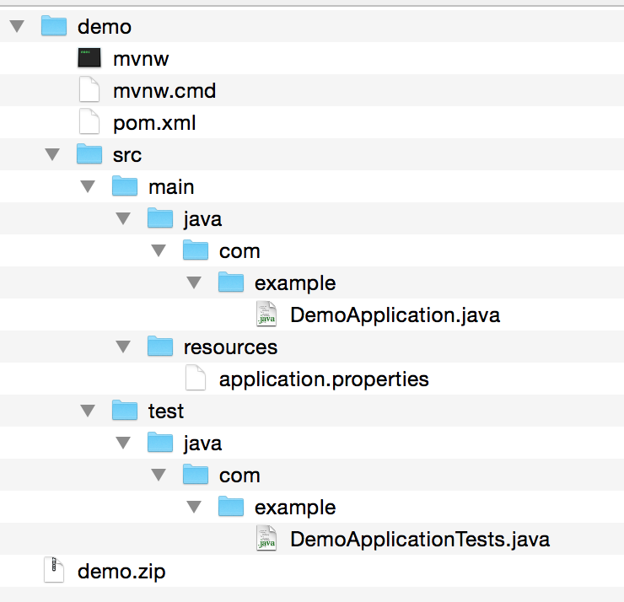

Slide 10
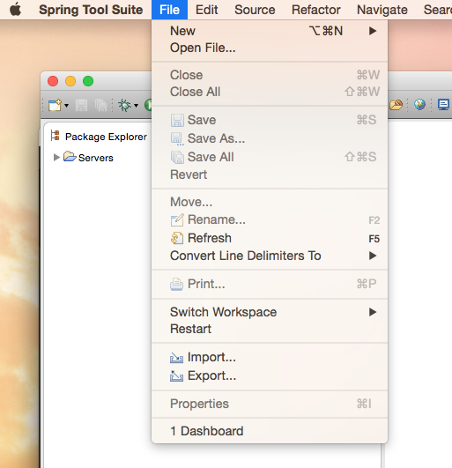

Slide 11
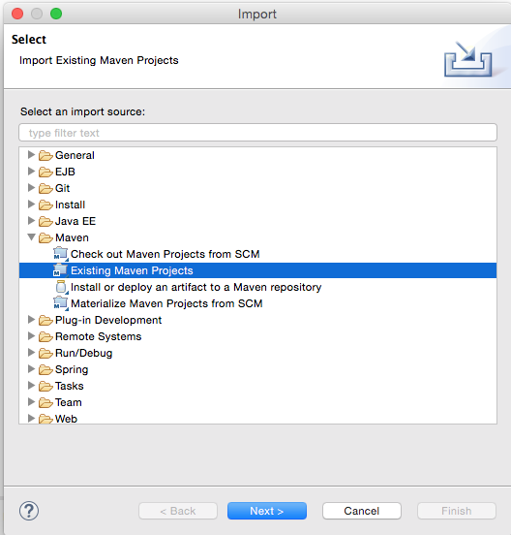

Slide 12
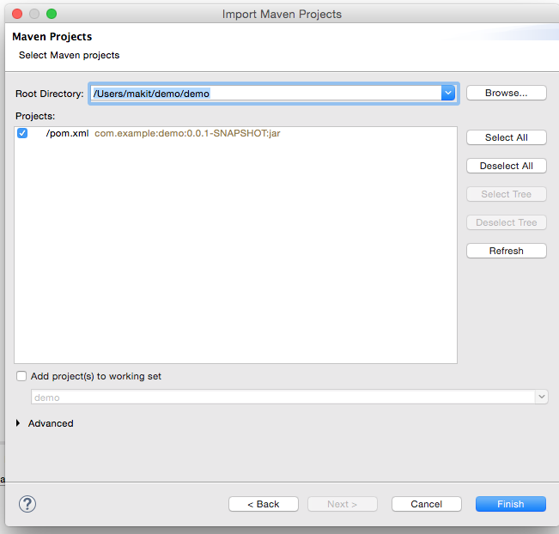

Slide 13
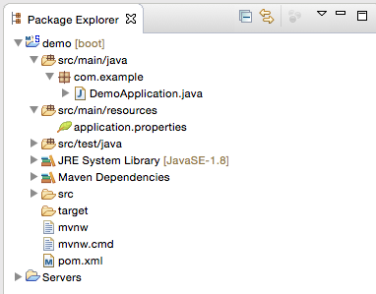

Slide 14
Boilerplate entry point
@SpringBootApplication public class DemoApplication { public static void main(String[] args) {
SpringApplication.run(DemoApplication.class,args); } }

Slide 15
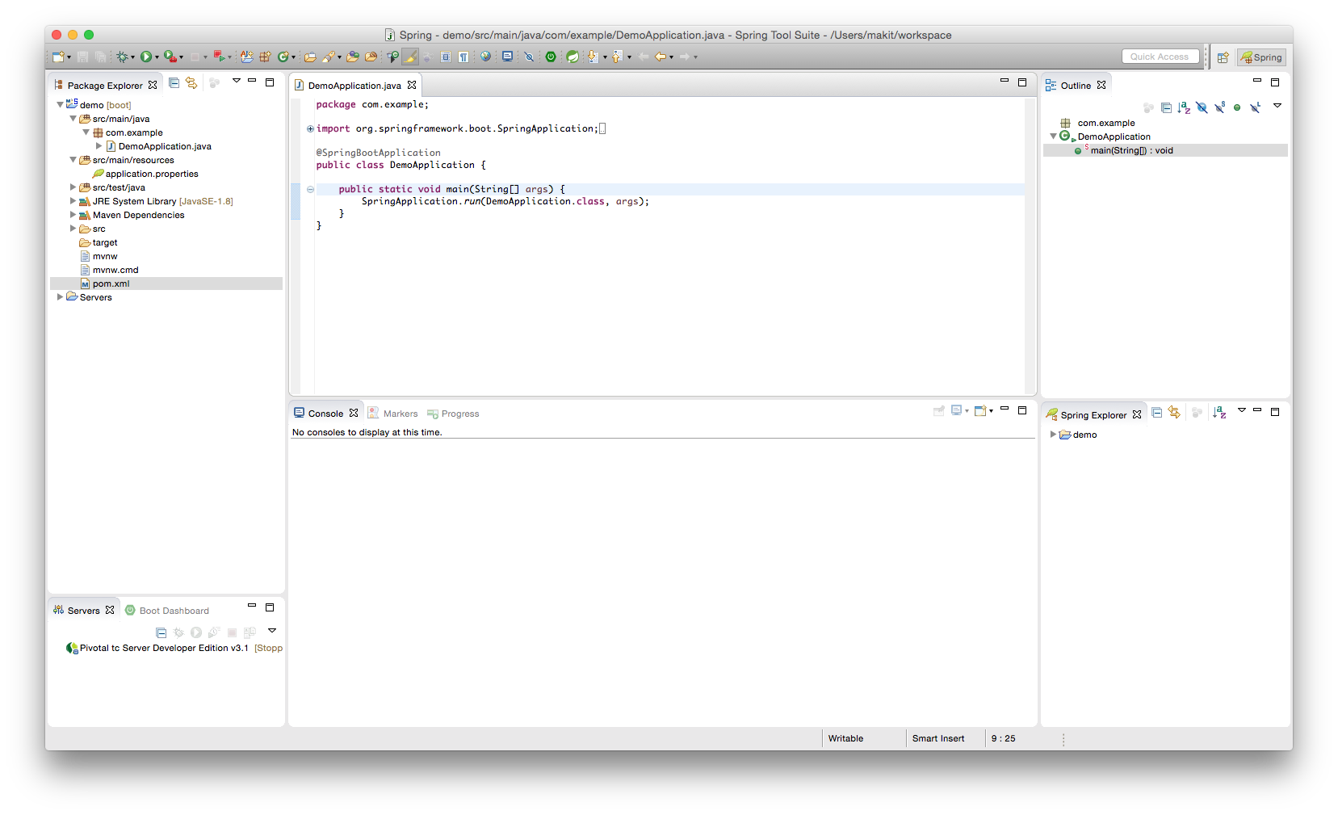
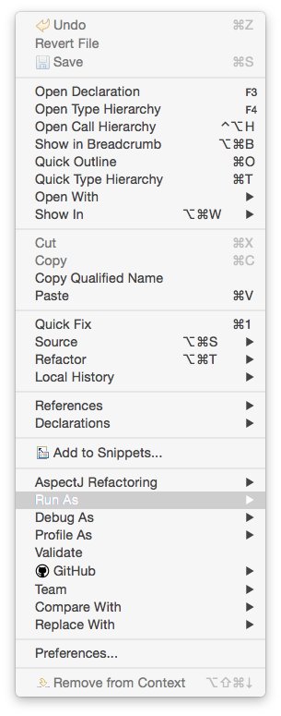
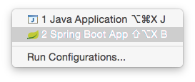

Slide 16
Output (01-01)
. ____ _ __ _ _
/\\ / ___'_ __ _ _(_)_ __ __ _ \ \ \ \
( ( )\___ | '_ | '_| | '_ \/ _` | \ \ \ \
\\/ ___)| |_)| | | | | || (_| | ) ) ) )
' |____| .__|_| |_|_| |_\__, | / / / /
=========|_|==============|___/=/_/_/_/
:: Spring Boot :: (v1.3.2.RELEASE)
2016-02-02 17:10:31.936 INFO 31599 --- [ main] com.example.DemoApplication : Starting DemoApplication on jpxxmakitm1.corp.emc.com with PID 31599 (/Users/makit/demo/demo/target/classes started by makit in /Users/makit/demo/demo)
2016-02-02 17:10:31.938 INFO 31599 --- [ main] com.example.DemoApplication : No active profile set, falling back to default profiles: default
2016-02-02 17:10:31.977 INFO 31599 --- [ main] s.c.a.AnnotationConfigApplicationContext : Refreshing org.springframework.context.annotation.AnnotationConfigApplicationContext@1ee807c6: startup date [Tue Feb 02 17:10:31 JST 2016]; root of context hierarchy
2016-02-02 17:10:32.494 INFO 31599 --- [ main] o.s.j.e.a.AnnotationMBeanExporter : Registering beans for JMX exposure on startup
2016-02-02 17:10:32.506 INFO 31599 --- [ main] com.example.DemoApplication : Started DemoApplication in 0.744 seconds (JVM running for 1.136)
2016-02-02 17:10:32.507 INFO 31599 --- [ Thread-1] s.c.a.AnnotationConfigApplicationContext : Closing org.springframework.context.annotation.AnnotationConfigApplicationContext@1ee807c6: startup date [Tue Feb 02 17:10:31 JST 2016]; root of context hierarchy
2016-02-02 17:10:32.509 INFO 31599 --- [ Thread-1] o.s.j.e.a.AnnotationMBeanExporter : Unregistering JMX-exposed beans on shutdown

Slide 17
Use CommandLineRunner
@SpringBootApplication public class DemoApplication implements CommandLineRunner { public static void main(String[] args) {
SpringApplication.run(DemoApplication.class,args); }
@Override
public void run(String... args) throws Exception {
System.out.println("Hello World!");
} }

Slide 18
Output (01-02)
. ____ _ __ _ _
/\\ / ___'_ __ _ _(_)_ __ __ _ \ \ \ \
( ( )\___ | '_ | '_| | '_ \/ _` | \ \ \ \
\\/ ___)| |_)| | | | | || (_| | ) ) ) )
' |____| .__|_| |_|_| |_\__, | / / / /
=========|_|==============|___/=/_/_/_/
:: Spring Boot :: (v1.3.2.RELEASE)
2016-02-02 17:37:50.505 INFO 31654 --- [ main] com.example.DemoApplication : Starting DemoApplication on jpxxmakitm1.corp.emc.com with PID 31654 (/Users/makit/demo/demo/target/classes started by makit in /Users/makit/demo/demo)
2016-02-02 17:37:50.507 INFO 31654 --- [ main] com.example.DemoApplication : No active profile set, falling back to default profiles: default
2016-02-02 17:37:50.544 INFO 31654 --- [ main] s.c.a.AnnotationConfigApplicationContext : Refreshing org.springframework.context.annotation.AnnotationConfigApplicationContext@517cd4b: startup date [Tue Feb 02 17:37:50 JST 2016]; root of context hierarchy
2016-02-02 17:37:51.052 INFO 31654 --- [ main] o.s.j.e.a.AnnotationMBeanExporter : Registering beans for JMX exposure on startup
Hello World!
2016-02-02 17:37:51.063 INFO 31654 --- [ main] com.example.DemoApplication : Started DemoApplication in 0.725 seconds (JVM running for 1.137)
2016-02-02 17:37:51.064 INFO 31654 --- [ Thread-1] s.c.a.AnnotationConfigApplicationContext : Closing org.springframework.context.annotation.AnnotationConfigApplicationContext@517cd4b: startup date [Tue Feb 02 17:37:50 JST 2016]; root of context hierarchy
2016-02-02 17:37:51.066 INFO 31654 --- [ Thread-1] o.s.j.e.a.AnnotationMBeanExporter : Unregistering JMX-exposed beans on shutdown

Slide 19
Make a first component
package com.example; public interface GreetingService { String greet(); }

Slide 20
Implement GreetingService
package com.example; public class SimpleGreetingService implements GreetingService {
@Override public String greet() {
return "Hello World!";
} }

Slide 21
Define a Bean
@SpringBootApplication public class DemoApplication implements CommandLineRunner {
@Bean
GreetingService greetingService() {
return new SimpleGreetingService();
}
public static void main(String[] args) {/* ommit */}
@Override
public void run(String... args) throws Exception {/* ommit */} }

Slide 22
Inject GreetingService & use this
@SpringBootApplication public class DemoApplication implements CommandLineRunner {
@Bean GreetingService greetingService() {/* ommit */}
@Autowired
GreetingService greetingService;
public static void main(String[] args) {/* ommit */}
@Override
public void run(String... args) throws Exception {
System.out.println(greetingService.greet());
} }

Slide 23
Output (01-03)
. ____ _ __ _ _
/\\ / ___'_ __ _ _(_)_ __ __ _ \ \ \ \
( ( )\___ | '_ | '_| | '_ \/ _` | \ \ \ \
\\/ ___)| |_)| | | | | || (_| | ) ) ) )
' |____| .__|_| |_|_| |_\__, | / / / /
=========|_|==============|___/=/_/_/_/
:: Spring Boot :: (v1.3.2.RELEASE)
2016-02-02 18:07:34.626 INFO 31879 --- [ main] com.example.DemoApplication : Starting DemoApplication on jpxxmakitm1.corp.emc.com with PID 31879 (/Users/makit/demo/demo/target/classes started by makit in /Users/makit/demo/demo)
2016-02-02 18:07:34.628 INFO 31879 --- [ main] com.example.DemoApplication : No active profile set, falling back to default profiles: default
2016-02-02 18:07:34.665 INFO 31879 --- [ main] s.c.a.AnnotationConfigApplicationContext : Refreshing org.springframework.context.annotation.AnnotationConfigApplicationContext@517cd4b: startup date [Tue Feb 02 18:07:34 JST 2016]; root of context hierarchy
2016-02-02 18:07:35.181 INFO 31879 --- [ main] o.s.j.e.a.AnnotationMBeanExporter : Registering beans for JMX exposure on startup
Hello World!
2016-02-02 18:07:35.196 INFO 31879 --- [ main] com.example.DemoApplication : Started DemoApplication in 0.736 seconds (JVM running for 1.579)
2016-02-02 18:07:35.198 INFO 31879 --- [ Thread-1] s.c.a.AnnotationConfigApplicationContext : Closing org.springframework.context.annotation.AnnotationConfigApplicationContext@517cd4b: startup date [Tue Feb 02 18:07:34 JST 2016]; root of context hierarchy
2016-02-02 18:07:35.200 INFO 31879 --- [ Thread-1] o.s.j.e.a.AnnotationMBeanExporter : Unregistering JMX-exposed beans on shutdown

Slide 24
Annotate with @Component
@Component public class SimpleGreetingService implements GreetingService {
@Override public String greet() {
return "Hello World!";
} }

Slide 25
Remove the Bean definition
@SpringBootApplication public class DemoApplication implements CommandLineRunner {
@Bean GreetingService greetingService() {/* ommit */}
@Autowired
GreetingService greetingService;
public static void main(String[] args) {/* ommit */}
@Override
public void run(String... args) throws Exception {
System.out.println(greetingService.greet());
} }
@Component public class SimpleGreetingService implements GreetingService {
@Override public String greet() {
return "Hello World!";
} }

Slide 26
Remove the Bean definition
@SpringBootApplication public class DemoApplication implements CommandLineRunner {
@Autowired
GreetingService greetingService;
public static void main(String[] args) {/* ommit */}
@Override
public void run(String... args) throws Exception {
System.out.println(greetingService.greet());
} }
@Component public class SimpleGreetingService implements GreetingService {
@Override public String greet() {
return "Hello World!";
} }

Slide 27
Output (01-04)
. ____ _ __ _ _
/\\ / ___'_ __ _ _(_)_ __ __ _ \ \ \ \
( ( )\___ | '_ | '_| | '_ \/ _` | \ \ \ \
\\/ ___)| |_)| | | | | || (_| | ) ) ) )
' |____| .__|_| |_|_| |_\__, | / / / /
=========|_|==============|___/=/_/_/_/
:: Spring Boot :: (v1.3.2.RELEASE)
2016-02-02 18:16:00.132 INFO 32066 --- [ main] com.example.DemoApplication : Starting DemoApplication on jpxxmakitm1.corp.emc.com with PID 32066 (/Users/makit/demo/demo/target/classes started by makit in /Users/makit/demo/demo)
2016-02-02 18:16:00.134 INFO 32066 --- [ main] com.example.DemoApplication : No active profile set, falling back to default profiles: default
2016-02-02 18:16:00.171 INFO 32066 --- [ main] s.c.a.AnnotationConfigApplicationContext : Refreshing org.springframework.context.annotation.AnnotationConfigApplicationContext@517cd4b: startup date [Tue Feb 02 18:16:00 JST 2016]; root of context hierarchy
2016-02-02 18:16:00.681 INFO 32066 --- [ main] o.s.j.e.a.AnnotationMBeanExporter : Registering beans for JMX exposure on startup
Hello World!
2016-02-02 18:16:00.693 INFO 32066 --- [ main] com.example.DemoApplication : Started DemoApplication in 0.739 seconds (JVM running for 1.139)
2016-02-02 18:16:00.694 INFO 32066 --- [ Thread-1] s.c.a.AnnotationConfigApplicationContext : Closing org.springframework.context.annotation.AnnotationConfigApplicationContext@517cd4b: startup date [Tue Feb 02 18:16:00 JST 2016]; root of context hierarchy
2016-02-02 18:16:00.696 INFO 32066 --- [ Thread-1] o.s.j.e.a.AnnotationMBeanExporter : Unregistering JMX-exposed beans on shutdown

Slide 28
Make another GreetingService
@Component public class PropertyGreetingService implements GreetingService {
@Value("${greeting.message}")
String message;
@Override public String greet() {
return message;
} }

Slide 29
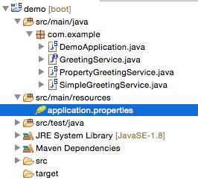
Configure the property

Slide 30
Make another GreetingService
greeting.message=Hello New World!

Slide 31
Remove @Component from Simple
@Component public class SimpleGreetingService implements GreetingService {
@Override public String greet() {
return "Hello World!";
} }

Slide 32
Remove @Component from Simple
public class SimpleGreetingService implements GreetingService {
@Override public String greet() {
return "Hello World!";
} }

Slide 33
Output (01-05)
. ____ _ __ _ _
/\\ / ___'_ __ _ _(_)_ __ __ _ \ \ \ \
( ( )\___ | '_ | '_| | '_ \/ _` | \ \ \ \
\\/ ___)| |_)| | | | | || (_| | ) ) ) )
' |____| .__|_| |_|_| |_\__, | / / / /
=========|_|==============|___/=/_/_/_/
:: Spring Boot :: (v1.3.2.RELEASE)
2016-02-02 18:31:48.618 INFO 32150 --- [ main] com.example.DemoApplication : Starting DemoApplication on jpxxmakitm1.corp.emc.com with PID 32150 (/Users/makit/demo/demo/target/classes started by makit in /Users/makit/demo/demo)
2016-02-02 18:31:48.621 INFO 32150 --- [ main] com.example.DemoApplication : No active profile set, falling back to default profiles: default
2016-02-02 18:31:48.657 INFO 32150 --- [ main] s.c.a.AnnotationConfigApplicationContext : Refreshing org.springframework.context.annotation.AnnotationConfigApplicationContext@517cd4b: startup date [Tue Feb 02 18:31:48 JST 2016]; root of context hierarchy
2016-02-02 18:31:49.183 INFO 32150 --- [ main] o.s.j.e.a.AnnotationMBeanExporter : Registering beans for JMX exposure on startup
Hello New World!
2016-02-02 18:31:49.195 INFO 32150 --- [ main] com.example.DemoApplication : Started DemoApplication in 0.763 seconds (JVM running for 1.175)
2016-02-02 18:31:49.196 INFO 32150 --- [ Thread-1] s.c.a.AnnotationConfigApplicationContext : Closing org.springframework.context.annotation.AnnotationConfigApplicationContext@517cd4b: startup date [Tue Feb 02 18:31:48 JST 2016]; root of context hierarchy
2016-02-02 18:31:49.198 INFO 32150 --- [ Thread-1] o.s.j.e.a.AnnotationMBeanExporter : Unregistering JMX-exposed beans on shutdown

Slide 34
What happen unless remove
@Component // <---- public class SimpleGreetingService implements GreetingService {
@Override public String greet() {
return "Hello World!";
} }

Slide 35
Output
com.example.DemoApplication.greetingService; nested exception is org.springframework.beans.factory.NoUniqueBeanDefinitionException: No qualifying bean of type [com.example.GreetingService] is defined: expected single matching bean but found 2: propertyGreetingService,simpleGreetingService
at org.springframework.beans.factory.annotation.AutowiredAnnotationBeanPostProcessor$AutowiredFieldElement.inject(AutowiredAnnotationBeanPostProcessor.java:573) ~[spring-beans-4.2.4.RELEASE.jar:4.2.4.RELEASE]
at org.springframework.beans.factory.annotation.InjectionMetadata.inject(InjectionMetadata.java:88) ~[spring-beans-4.2.4.RELEASE.jar:4.2.4.RELEASE]
at org.springframework.beans.factory.annotation.AutowiredAnnotationBeanPostProcessor.postProcessPropertyValues(AutowiredAnnotationBeanPostProcessor.java:331) ~[spring-beans-4.2.4.RELEASE.jar:4.2.4.RELEASE]
... 16 common frames omitted
Caused by: org.springframework.beans.factory.NoUniqueBeanDefinitionException: No qualifying bean of type [com.example.GreetingService] is defined: expected single matching bean but found 2: propertyGreetingService,simpleGreetingService
at org.springframework.beans.factory.support.DefaultListableBeanFactory.doResolveDependency(DefaultListableBeanFactory.java:1126) ~[spring-beans-4.2.4.RELEASE.jar:4.2.4.RELEASE]
at org.springframework.beans.factory.support.DefaultListableBeanFactory.resolveDependency(DefaultListableBeanFactory.java:1014) ~[spring-beans-4.2.4.RELEASE.jar:4.2.4.RELEASE]
at org.springframework.beans.factory.annotation.AutowiredAnnotationBeanPostProcessor$AutowiredFieldElement.inject(AutowiredAnnotationBeanPostProcessor.java:545) ~[spring-beans-4.2.4.RELEASE.jar:4.2.4.RELEASE]
... 18 common frames omitted

Slide 36
Solutions
Specify the Bean name explicitly with @Qualifier + @Autowired
Remove @Component from both and specify the concrete bean with @Bean
Annotate @Primary on preferred one

Slide 37
Solution 1
@SpringBootApplication public class DemoApplication implements CommandLineRunner {
@Autowired
@Qualifier("propertyGreetingService") // or simpleGreeting...
GreetingService greetingService;
public static void main(String[] args) {/* ommit */}
@Override
public void run(String... args) throws Exception {
System.out.println(greetingService.greet());
} }

Slide 38
Output (01-06)
. ____ _ __ _ _
/\\ / ___'_ __ _ _(_)_ __ __ _ \ \ \ \
( ( )\___ | '_ | '_| | '_ \/ _` | \ \ \ \
\\/ ___)| |_)| | | | | || (_| | ) ) ) )
' |____| .__|_| |_|_| |_\__, | / / / /
=========|_|==============|___/=/_/_/_/
:: Spring Boot :: (v1.3.2.RELEASE)
2016-02-02 18:47:47.412 INFO 32172 --- [ main] com.example.DemoApplication : Starting DemoApplication on jpxxmakitm1.corp.emc.com with PID 32172 (/Users/makit/demo/demo/target/classes started by makit in /Users/makit/demo/demo)
2016-02-02 18:47:47.414 INFO 32172 --- [ main] com.example.DemoApplication : No active profile set, falling back to default profiles: default
2016-02-02 18:47:47.450 INFO 32172 --- [ main] s.c.a.AnnotationConfigApplicationContext : Refreshing org.springframework.context.annotation.AnnotationConfigApplicationContext@517cd4b: startup date [Tue Feb 02 18:47:47 JST 2016]; root of context hierarchy
2016-02-02 18:47:48.036 INFO 32172 --- [ main] o.s.j.e.a.AnnotationMBeanExporter : Registering beans for JMX exposure on startup
Hello New World!
2016-02-02 18:47:48.054 INFO 32172 --- [ main] com.example.DemoApplication : Started DemoApplication in 0.815 seconds (JVM running for 1.23)
2016-02-02 18:47:48.055 INFO 32172 --- [ Thread-1] s.c.a.AnnotationConfigApplicationContext : Closing org.springframework.context.annotation.AnnotationConfigApplicationContext@517cd4b: startup date [Tue Feb 02 18:47:47 JST 2016]; root of context hierarchy
2016-02-02 18:47:48.057 INFO 32172 --- [ Thread-1] o.s.j.e.a.AnnotationMBeanExporter : Unregistering JMX-exposed beans on shutdown

Slide 39
Solution 2
@SpringBootApplication public class DemoApplication implements CommandLineRunner {
@Bean // remove @Component from both GreetingService
GreetingService greetingService() {
return new PropertyGreetingService();
}
public static void main(String[] args) {/* ommit */}
@Override
public void run(String... args) throws Exception {/* ommit */} }

Slide 40
Output (01-07)
. ____ _ __ _ _
/\\ / ___'_ __ _ _(_)_ __ __ _ \ \ \ \
( ( )\___ | '_ | '_| | '_ \/ _` | \ \ \ \
\\/ ___)| |_)| | | | | || (_| | ) ) ) )
' |____| .__|_| |_|_| |_\__, | / / / /
=========|_|==============|___/=/_/_/_/
:: Spring Boot :: (v1.3.2.RELEASE)
2016-02-02 18:47:47.412 INFO 32172 --- [ main] com.example.DemoApplication : Starting DemoApplication on jpxxmakitm1.corp.emc.com with PID 32172 (/Users/makit/demo/demo/target/classes started by makit in /Users/makit/demo/demo)
2016-02-02 18:47:47.414 INFO 32172 --- [ main] com.example.DemoApplication : No active profile set, falling back to default profiles: default
2016-02-02 18:47:47.450 INFO 32172 --- [ main] s.c.a.AnnotationConfigApplicationContext : Refreshing org.springframework.context.annotation.AnnotationConfigApplicationContext@517cd4b: startup date [Tue Feb 02 18:47:47 JST 2016]; root of context hierarchy
2016-02-02 18:47:48.036 INFO 32172 --- [ main] o.s.j.e.a.AnnotationMBeanExporter : Registering beans for JMX exposure on startup
Hello New World!
2016-02-02 18:47:48.054 INFO 32172 --- [ main] com.example.DemoApplication : Started DemoApplication in 0.815 seconds (JVM running for 1.23)
2016-02-02 18:47:48.055 INFO 32172 --- [ Thread-1] s.c.a.AnnotationConfigApplicationContext : Closing org.springframework.context.annotation.AnnotationConfigApplicationContext@517cd4b: startup date [Tue Feb 02 18:47:47 JST 2016]; root of context hierarchy
2016-02-02 18:47:48.057 INFO 32172 --- [ Thread-1] o.s.j.e.a.AnnotationMBeanExporter : Unregistering JMX-exposed beans on shutdown

Slide 41
Solution 3
@Component
@Primary public class PropertyGreetingService implements GreetingService {
@Value("${greeting.message}")
String message;
@Override public String greet() {
return message;
} }

Slide 42
Output (01-08)
. ____ _ __ _ _
/\\ / ___'_ __ _ _(_)_ __ __ _ \ \ \ \
( ( )\___ | '_ | '_| | '_ \/ _` | \ \ \ \
\\/ ___)| |_)| | | | | || (_| | ) ) ) )
' |____| .__|_| |_|_| |_\__, | / / / /
=========|_|==============|___/=/_/_/_/
:: Spring Boot :: (v1.3.2.RELEASE)
2016-02-02 18:47:47.412 INFO 32172 --- [ main] com.example.DemoApplication : Starting DemoApplication on jpxxmakitm1.corp.emc.com with PID 32172 (/Users/makit/demo/demo/target/classes started by makit in /Users/makit/demo/demo)
2016-02-02 18:47:47.414 INFO 32172 --- [ main] com.example.DemoApplication : No active profile set, falling back to default profiles: default
2016-02-02 18:47:47.450 INFO 32172 --- [ main] s.c.a.AnnotationConfigApplicationContext : Refreshing org.springframework.context.annotation.AnnotationConfigApplicationContext@517cd4b: startup date [Tue Feb 02 18:47:47 JST 2016]; root of context hierarchy
2016-02-02 18:47:48.036 INFO 32172 --- [ main] o.s.j.e.a.AnnotationMBeanExporter : Registering beans for JMX exposure on startup
Hello New World!
2016-02-02 18:47:48.054 INFO 32172 --- [ main] com.example.DemoApplication : Started DemoApplication in 0.815 seconds (JVM running for 1.23)
2016-02-02 18:47:48.055 INFO 32172 --- [ Thread-1] s.c.a.AnnotationConfigApplicationContext : Closing org.springframework.context.annotation.AnnotationConfigApplicationContext@517cd4b: startup date [Tue Feb 02 18:47:47 JST 2016]; root of context hierarchy
2016-02-02 18:47:48.057 INFO 32172 --- [ Thread-1] o.s.j.e.a.AnnotationMBeanExporter : Unregistering JMX-exposed beans on shutdown

Slide 43
Solution 4
@Component
@Vanilla public class SimpleGreetingService implements GreetingService {/*...*/}
@SpringBootApplication public class DemoApplication
implements CommandLineRunner {
@Autowired @Vanilla
GreetingService greetingService;
}

Slide 44
Solution 4
package com.example; import org.springframework.beans.factory.annotation.Qualifier; import java.lang.annotation.*;
@Target({ElementType.FIELD, ElementType.METHOD,
ElementType.TYPE}) @Retention(RetentionPolicy.RUNTIME) @Inherited @Documented @Qualifier public @interface Vanilla { }

Slide 45
Build the application
$ cd demo
$ mvn clean package -Dmaven.test.skip=true
$ java -jar target/demo-0.0.1-SNAPSHOT.jar

Slide 46
Change the property
$ java -jar target/demo-0.0.1-SNAPSHOT.jar --greeting.message=Hi
. ____ _ __ _ _
/\\ / ___'_ __ _ _(_)_ __ __ _ \ \ \ \
( ( )\___ | '_ | '_| | '_ \/ _` | \ \ \ \
\\/ ___)| |_)| | | | | || (_| | ) ) ) )
' |____| .__|_| |_|_| |_\__, | / / / /
=========|_|==============|___/=/_/_/_/
:: Spring Boot :: (v1.3.2.RELEASE)
2016-02-02 19:09:30.950 INFO 32418 --- [ main] com.example.DemoApplication : Starting DemoApplication v0.0.1-SNAPSHOT on jpxxmakitm1.corp.emc.com with PID 32418 (/Users/makit/demo/demo/target/demo-0.0.1-SNAPSHOT.jar started by makit in /Users/makit/demo/demo)
2016-02-02 19:09:30.953 INFO 32418 --- [ main] com.example.DemoApplication : No active profile set, falling back to default profiles: default
2016-02-02 19:09:30.998 INFO 32418 --- [ main] s.c.a.AnnotationConfigApplicationContext : Refreshing org.springframework.context.annotation.AnnotationConfigApplicationContext@7199f18b: startup date [Tue Feb 02 19:09:30 JST 2016]; root of context hierarchy
2016-02-02 19:09:31.628 INFO 32418 --- [ main] o.s.j.e.a.AnnotationMBeanExporter : Registering beans for JMX exposure on startup
Hi
2016-02-02 19:09:31.641 INFO 32418 --- [ main] com.example.DemoApplication : Started DemoApplication in 1.309 seconds (JVM running for 1.683)
2016-02-02 19:09:31.641 INFO 32418 --- [ Thread-2] s.c.a.AnnotationConfigApplicationContext : Closing org.springframework.context.annotation.AnnotationConfigApplicationContext@7199f18b: startup date [Tue Feb 02 19:09:30 JST 2016]; root of context hierarchy
2016-02-02 19:09:31.643 INFO 32418 --- [ Thread-2] o.s.j.e.a.AnnotationMBeanExporter : Unregistering JMX-exposed beans on shutdown

Slide 47
Web Application

Slide 48
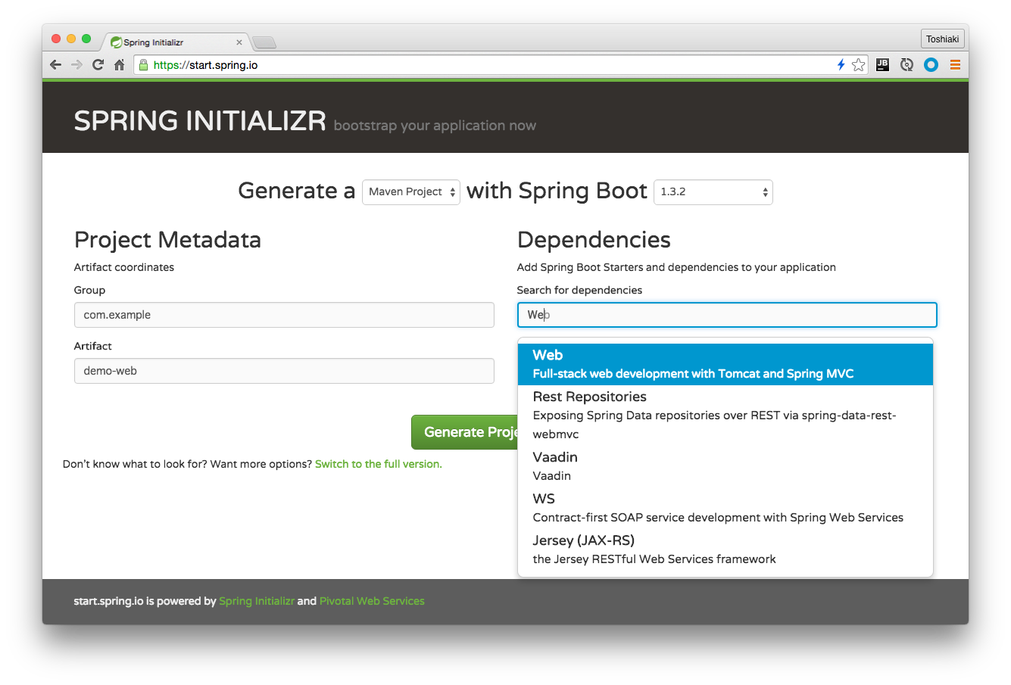

Slide 51
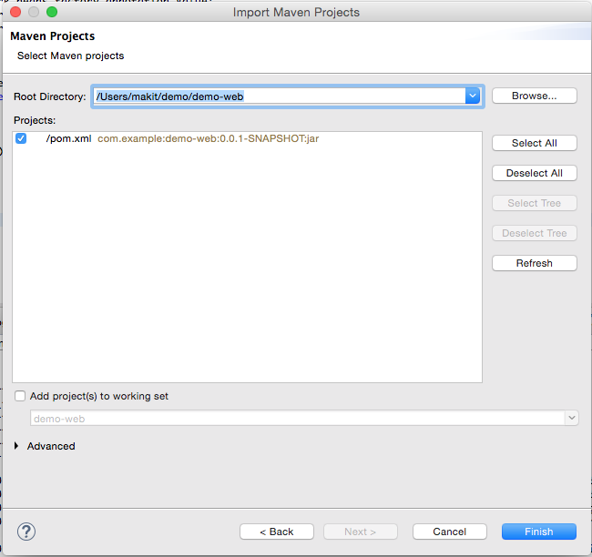

Slide 52
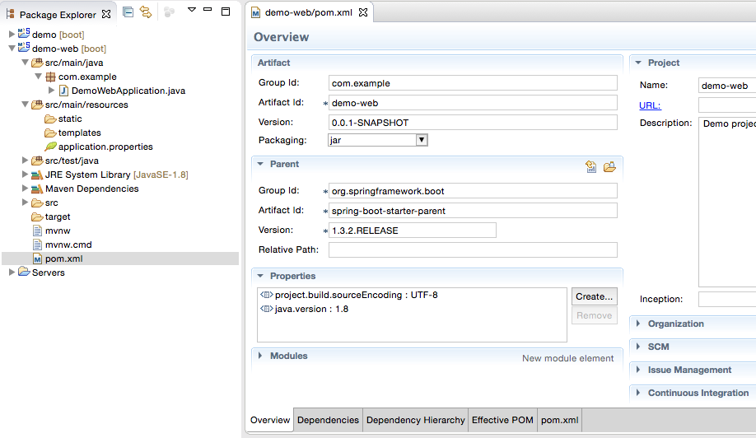

Slide 53
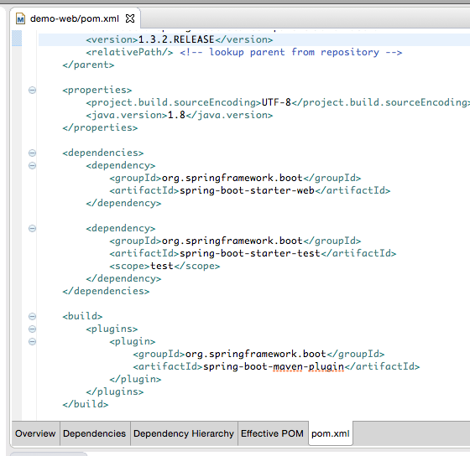
Added

Slide 54
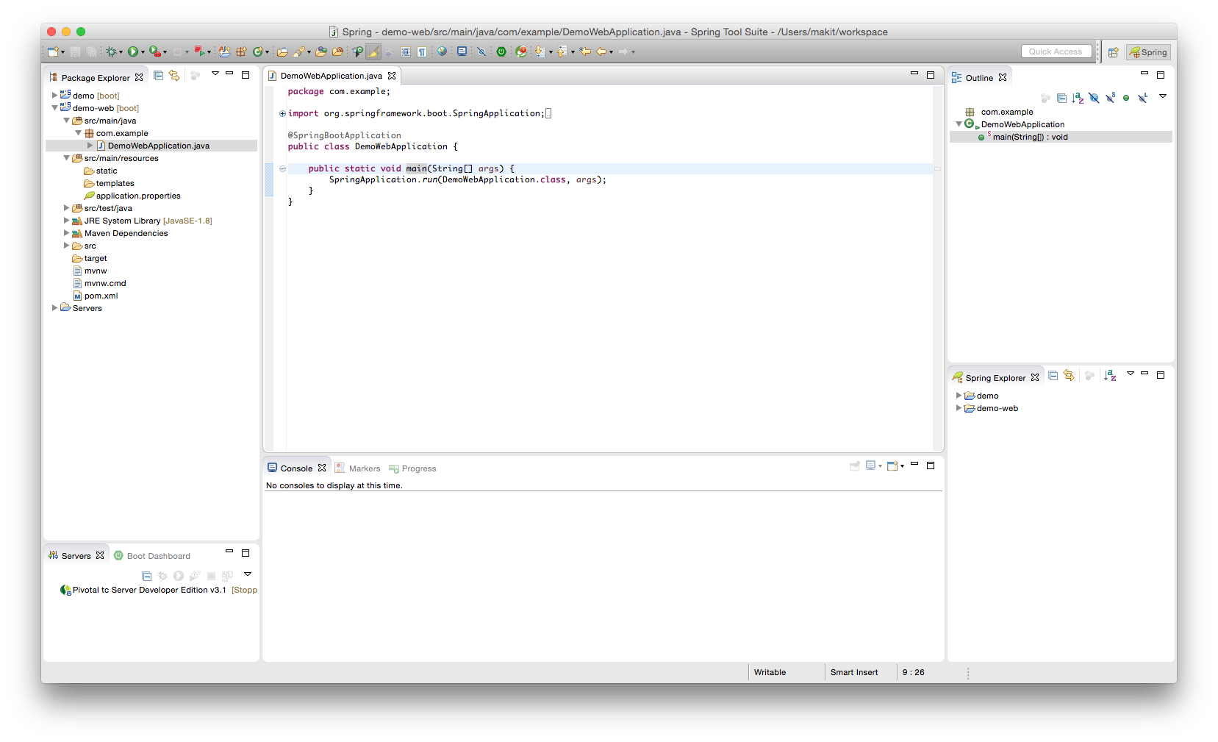

Slide 55
Output (02-01)
. ____ _ __ _ _
/\\ / ___'_ __ _ _(_)_ __ __ _ \ \ \ \
( ( )\___ | '_ | '_| | '_ \/ _` | \ \ \ \
\\/ ___)| |_)| | | | | || (_| | ) ) ) )
' |____| .__|_| |_|_| |_\__, | / / / /
=========|_|==============|___/=/_/_/_/
:: Spring Boot :: (v1.3.2.RELEASE)
2016-02-03 10:04:47.865 INFO 34438 --- [ main] com.example.DemoWebApplication : Starting DemoWebApplication on jpxxmakitm1.corp.emc.com with PID 34438 (/Users/makit/demo/demo-web/target/classes started by makit in /Users/makit/demo/demo-web)
2016-02-03 10:04:47.868 INFO 34438 --- [ main] com.example.DemoWebApplication : No active profile set, falling back to default profiles: default
2016-02-03 10:04:47.917 INFO 34438 --- [ main] ationConfigEmbeddedWebApplicationContext : Refreshing org.springframework.boot.context.embedded.AnnotationConfigEmbeddedWebApplicationContext@314c508a: startup date [Wed Feb 03 10:04:47 JST 2016]; root of context hierarchy
2016-02-03 10:04:48.408 INFO 34438 --- [ main] o.s.b.f.s.DefaultListableBeanFactory : Overriding bean definition for bean 'beanNameViewResolver' with a different definition: replacing [Root bean: class [null]; scope=; abstract=false; lazyInit=false; autowireMode=3; dependencyCheck=0; autowireCandidate=true; primary=false; factoryBeanName=org.springframework.boot.autoconfigure.web.ErrorMvcAutoConfiguration$WhitelabelErrorViewConfiguration; factoryMethodName=beanNameViewResolver; initMethodName=null; destroyMethodName=(inferred); defined in class path resource [org/springframework/boot/autoconfigure/web/ErrorMvcAutoConfiguration$WhitelabelErrorViewConfiguration.class]] with [Root bean: class [null]; scope=; abstract=false; lazyInit=false; autowireMode=3; dependencyCheck=0; autowireCandidate=true; primary=false; factoryBeanName=org.springframework.boot.autoconfigure.web.WebMvcAutoConfiguration$WebMvcAutoConfigurationAdapter; factoryMethodName=beanNameViewResolver; initMethodName=null; destroyMethodName=(inferred); defined in class path resource [org/springframework/boot/autoconfigure/web/WebMvcAutoConfiguration$WebMvcAutoConfigurationAdapter.class]]
2016-02-03 10:04:48.932 INFO 34438 --- [ main] s.b.c.e.t.TomcatEmbeddedServletContainer : Tomcat initialized with port(s): 8080 (http)
2016-02-03 10:04:48.945 INFO 34438 --- [ main] o.apache.catalina.core.StandardService : Starting service Tomcat
2016-02-03 10:04:48.946 INFO 34438 --- [ main] org.apache.catalina.core.StandardEngine : Starting Servlet Engine: Apache Tomcat/8.0.30
2016-02-03 10:04:49.031 INFO 34438 --- [ost-startStop-1] o.a.c.c.C.[Tomcat].[localhost].[/] : Initializing Spring embedded WebApplicationContext
2016-02-03 10:04:49.031 INFO 34438 --- [ost-startStop-1] o.s.web.context.ContextLoader : Root WebApplicationContext: initialization completed in 1119 ms
2016-02-03 10:04:49.251 INFO 34438 --- [ost-startStop-1] o.s.b.c.e.ServletRegistrationBean : Mapping servlet: 'dispatcherServlet' to [/]
2016-02-03 10:04:49.254 INFO 34438 --- [ost-startStop-1] o.s.b.c.embedded.FilterRegistrationBean : Mapping filter: 'characterEncodingFilter' to: [/*]
2016-02-03 10:04:49.255 INFO 34438 --- [ost-startStop-1] o.s.b.c.embedded.FilterRegistrationBean : Mapping filter: 'hiddenHttpMethodFilter' to: [/*]
2016-02-03 10:04:49.255 INFO 34438 --- [ost-startStop-1] o.s.b.c.embedded.FilterRegistrationBean : Mapping filter: 'httpPutFormContentFilter' to: [/*]
2016-02-03 10:04:49.255 INFO 34438 --- [ost-startStop-1] o.s.b.c.embedded.FilterRegistrationBean : Mapping filter: 'requestContextFilter' to: [/*]
2016-02-03 10:04:49.506 INFO 34438 --- [ main] s.w.s.m.m.a.RequestMappingHandlerAdapter : Looking for @ControllerAdvice: org.springframework.boot.context.embedded.AnnotationConfigEmbeddedWebApplicationContext@314c508a: startup date [Wed Feb 03 10:04:47 JST 2016]; root of context hierarchy
2016-02-03 10:04:49.561 INFO 34438 --- [ main] s.w.s.m.m.a.RequestMappingHandlerMapping : Mapped "{[/error]}" onto public org.springframework.http.ResponseEntity<java.util.Map<java.lang.String, java.lang.Object>> org.springframework.boot.autoconfigure.web.BasicErrorController.error(javax.servlet.http.HttpServletRequest)
2016-02-03 10:04:49.562 INFO 34438 --- [ main] s.w.s.m.m.a.RequestMappingHandlerMapping : Mapped "{[/error],produces=[text/html]}" onto public org.springframework.web.servlet.ModelAndView org.springframework.boot.autoconfigure.web.BasicErrorController.errorHtml(javax.servlet.http.HttpServletRequest,javax.servlet.http.HttpServletResponse)
2016-02-03 10:04:49.584 INFO 34438 --- [ main] o.s.w.s.handler.SimpleUrlHandlerMapping : Mapped URL path [/webjars/**] onto handler of type [class org.springframework.web.servlet.resource.ResourceHttpRequestHandler]
2016-02-03 10:04:49.585 INFO 34438 --- [ main] o.s.w.s.handler.SimpleUrlHandlerMapping : Mapped URL path [/**] onto handler of type [class org.springframework.web.servlet.resource.ResourceHttpRequestHandler]
2016-02-03 10:04:49.610 INFO 34438 --- [ main] o.s.w.s.handler.SimpleUrlHandlerMapping : Mapped URL path [/**/favicon.ico] onto handler of type [class org.springframework.web.servlet.resource.ResourceHttpRequestHandler]
2016-02-03 10:04:49.699 INFO 34438 --- [ main] o.s.j.e.a.AnnotationMBeanExporter : Registering beans for JMX exposure on startup
2016-02-03 10:04:49.766 INFO 34438 --- [ main] s.b.c.e.t.TomcatEmbeddedServletContainer : Tomcat started on port(s): 8080 (http)
2016-02-03 10:04:49.770 INFO 34438 --- [ main] com.example.DemoWebApplication : Started DemoWebApplication in 2.159 seconds (JVM running for 3.141)

Slide 56
First Controller
@SpringBootApplication
@RestController public class DemoApplication {
@RequestMapping("/")
String hello() {
return "Hello World!";
}
public static void main(String[] args) {
SpringApplication.run(DemoApplication.class,args); } }

Slide 57
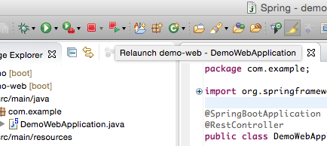

Slide 58
Output (02-02)
. ____ _ __ _ _
/\\ / ___'_ __ _ _(_)_ __ __ _ \ \ \ \
( ( )\___ | '_ | '_| | '_ \/ _` | \ \ \ \
\\/ ___)| |_)| | | | | || (_| | ) ) ) )
' |____| .__|_| |_|_| |_\__, | / / / /
=========|_|==============|___/=/_/_/_/
:: Spring Boot :: (v1.3.2.RELEASE)
2016-02-03 10:38:24.543 INFO 34688 --- [ main] com.example.DemoWebApplication : Starting DemoWebApplication on jpxxmakitm1.corp.emc.com with PID 34688 (/Users/makit/demo/demo-web/target/classes started by makit in /Users/makit/demo/demo-web)
2016-02-03 10:38:24.546 INFO 34688 --- [ main] com.example.DemoWebApplication : No active profile set, falling back to default profiles: default
2016-02-03 10:38:24.600 INFO 34688 --- [ main] ationConfigEmbeddedWebApplicationContext : Refreshing org.springframework.boot.context.embedded.AnnotationConfigEmbeddedWebApplicationContext@314c508a: startup date [Wed Feb 03 10:38:24 JST 2016]; root of context hierarchy
2016-02-03 10:38:25.103 INFO 34688 --- [ main] o.s.b.f.s.DefaultListableBeanFactory : Overriding bean definition for bean 'beanNameViewResolver' with a different definition: replacing [Root bean: class [null]; scope=; abstract=false; lazyInit=false; autowireMode=3; dependencyCheck=0; autowireCandidate=true; primary=false; factoryBeanName=org.springframework.boot.autoconfigure.web.ErrorMvcAutoConfiguration$WhitelabelErrorViewConfiguration; factoryMethodName=beanNameViewResolver; initMethodName=null; destroyMethodName=(inferred); defined in class path resource [org/springframework/boot/autoconfigure/web/ErrorMvcAutoConfiguration$WhitelabelErrorViewConfiguration.class]] with [Root bean: class [null]; scope=; abstract=false; lazyInit=false; autowireMode=3; dependencyCheck=0; autowireCandidate=true; primary=false; factoryBeanName=org.springframework.boot.autoconfigure.web.WebMvcAutoConfiguration$WebMvcAutoConfigurationAdapter; factoryMethodName=beanNameViewResolver; initMethodName=null; destroyMethodName=(inferred); defined in class path resource [org/springframework/boot/autoconfigure/web/WebMvcAutoConfiguration$WebMvcAutoConfigurationAdapter.class]]
2016-02-03 10:38:25.709 INFO 34688 --- [ main] s.b.c.e.t.TomcatEmbeddedServletContainer : Tomcat initialized with port(s): 8080 (http)
2016-02-03 10:38:25.722 INFO 34688 --- [ main] o.apache.catalina.core.StandardService : Starting service Tomcat
2016-02-03 10:38:25.723 INFO 34688 --- [ main] org.apache.catalina.core.StandardEngine : Starting Servlet Engine: Apache Tomcat/8.0.30
2016-02-03 10:38:25.824 INFO 34688 --- [ost-startStop-1] o.a.c.c.C.[Tomcat].[localhost].[/] : Initializing Spring embedded WebApplicationContext
2016-02-03 10:38:25.824 INFO 34688 --- [ost-startStop-1] o.s.web.context.ContextLoader : Root WebApplicationContext: initialization completed in 1227 ms
2016-02-03 10:38:26.103 INFO 34688 --- [ost-startStop-1] o.s.b.c.e.ServletRegistrationBean : Mapping servlet: 'dispatcherServlet' to [/]
2016-02-03 10:38:26.107 INFO 34688 --- [ost-startStop-1] o.s.b.c.embedded.FilterRegistrationBean : Mapping filter: 'characterEncodingFilter' to: [/*]
2016-02-03 10:38:26.108 INFO 34688 --- [ost-startStop-1] o.s.b.c.embedded.FilterRegistrationBean : Mapping filter: 'hiddenHttpMethodFilter' to: [/*]
2016-02-03 10:38:26.108 INFO 34688 --- [ost-startStop-1] o.s.b.c.embedded.FilterRegistrationBean : Mapping filter: 'httpPutFormContentFilter' to: [/*]
2016-02-03 10:38:26.108 INFO 34688 --- [ost-startStop-1] o.s.b.c.embedded.FilterRegistrationBean : Mapping filter: 'requestContextFilter' to: [/*]
2016-02-03 10:38:26.329 INFO 34688 --- [ main] s.w.s.m.m.a.RequestMappingHandlerAdapter : Looking for @ControllerAdvice: org.springframework.boot.context.embedded.AnnotationConfigEmbeddedWebApplicationContext@314c508a: startup date [Wed Feb 03 10:38:24 JST 2016]; root of context hierarchy
2016-02-03 10:38:26.392 INFO 34688 --- [ main] s.w.s.m.m.a.RequestMappingHandlerMapping : Mapped "{[/]}" onto java.lang.String com.example.DemoWebApplication.hello()
2016-02-03 10:38:26.394 INFO 34688 --- [ main] s.w.s.m.m.a.RequestMappingHandlerMapping : Mapped "{[/error]}" onto public org.springframework.http.ResponseEntity<java.util.Map<java.lang.String, java.lang.Object>> org.springframework.boot.autoconfigure.web.BasicErrorController.error(javax.servlet.http.HttpServletRequest)
2016-02-03 10:38:26.395 INFO 34688 --- [ main] s.w.s.m.m.a.RequestMappingHandlerMapping : Mapped "{[/error],produces=[text/html]}" onto public org.springframework.web.servlet.ModelAndView org.springframework.boot.autoconfigure.web.BasicErrorController.errorHtml(javax.servlet.http.HttpServletRequest,javax.servlet.http.HttpServletResponse)
2016-02-03 10:38:26.421 INFO 34688 --- [ main] o.s.w.s.handler.SimpleUrlHandlerMapping : Mapped URL path [/webjars/**] onto handler of type [class org.springframework.web.servlet.resource.ResourceHttpRequestHandler]
2016-02-03 10:38:26.421 INFO 34688 --- [ main] o.s.w.s.handler.SimpleUrlHandlerMapping : Mapped URL path [/**] onto handler of type [class org.springframework.web.servlet.resource.ResourceHttpRequestHandler]
2016-02-03 10:38:26.459 INFO 34688 --- [ main] o.s.w.s.handler.SimpleUrlHandlerMapping : Mapped URL path [/**/favicon.ico] onto handler of type [class org.springframework.web.servlet.resource.ResourceHttpRequestHandler]
2016-02-03 10:38:26.575 INFO 34688 --- [ main] o.s.j.e.a.AnnotationMBeanExporter : Registering beans for JMX exposure on startup
2016-02-03 10:38:26.648 INFO 34688 --- [ main] s.b.c.e.t.TomcatEmbeddedServletContainer : Tomcat started on port(s): 8080 (http)
2016-02-03 10:38:26.654 INFO 34688 --- [ main] com.example.DemoWebApplication : Started DemoWebApplication in 2.337 seconds (JVM running for 2.826)

Slide 59
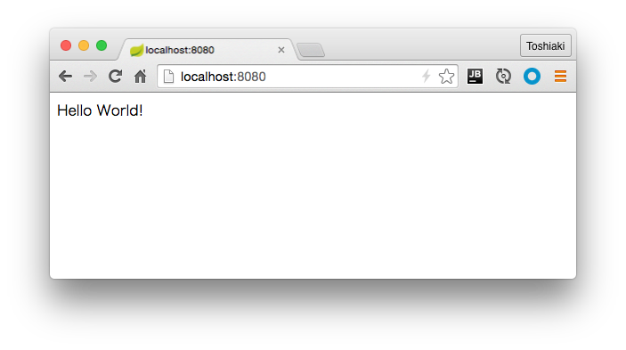
http://localhost:8080

Slide 60
Create new Controller (REST API)
package com.example;
public class City {
private Integer id;
private String name;
public Integer getId() {
return id;
}
public void setId(Integer id) {
this.id = id;
}
public String getName() {
return name;
}
public void setName(String name) {
this.name = name;
}
}

Slide 61
Create new Controller (REST API)
@RestController
public class CityController {
static List<City> cities = new CopyOnWriteArrayList<>();
static AtomicInteger counter = new AtomicInteger(0);
@RequestMapping(value = "/cities", method = RequestMethod.GET)
List<City> getCities() {
return cities;
}
@RequestMapping(value = "/cities", method = RequestMethod.POST)
City postCities(@RequestBody City city) {
city.setId(counter.incrementAndGet());
cities.add(city);
return city;
}
}

Slide 62
Output (02-03)
. ____ _ __ _ _
/\\ / ___'_ __ _ _(_)_ __ __ _ \ \ \ \
( ( )\___ | '_ | '_| | '_ \/ _` | \ \ \ \
\\/ ___)| |_)| | | | | || (_| | ) ) ) )
' |____| .__|_| |_|_| |_\__, | / / / /
=========|_|==============|___/=/_/_/_/
:: Spring Boot :: (v1.3.2.RELEASE)
2016-02-03 12:29:20.953 INFO 35680 --- [ main] com.example.DemoWebApplication : Starting DemoWebApplication on jpxxmakitm1.corp.emc.com with PID 35680 (/Users/makit/demo/demo-web/target/classes started by makit in /Users/makit/demo/demo-web)
2016-02-03 12:29:20.955 INFO 35680 --- [ main] com.example.DemoWebApplication : No active profile set, falling back to default profiles: default
2016-02-03 12:29:21.003 INFO 35680 --- [ main] ationConfigEmbeddedWebApplicationContext : Refreshing org.springframework.boot.context.embedded.AnnotationConfigEmbeddedWebApplicationContext@314c508a: startup date [Wed Feb 03 12:29:21 JST 2016]; root of context hierarchy
2016-02-03 12:29:21.466 INFO 35680 --- [ main] o.s.b.f.s.DefaultListableBeanFactory : Overriding bean definition for bean 'beanNameViewResolver' with a different definition: replacing [Root bean: class [null]; scope=; abstract=false; lazyInit=false; autowireMode=3; dependencyCheck=0; autowireCandidate=true; primary=false; factoryBeanName=org.springframework.boot.autoconfigure.web.ErrorMvcAutoConfiguration$WhitelabelErrorViewConfiguration; factoryMethodName=beanNameViewResolver; initMethodName=null; destroyMethodName=(inferred); defined in class path resource [org/springframework/boot/autoconfigure/web/ErrorMvcAutoConfiguration$WhitelabelErrorViewConfiguration.class]] with [Root bean: class [null]; scope=; abstract=false; lazyInit=false; autowireMode=3; dependencyCheck=0; autowireCandidate=true; primary=false; factoryBeanName=org.springframework.boot.autoconfigure.web.WebMvcAutoConfiguration$WebMvcAutoConfigurationAdapter; factoryMethodName=beanNameViewResolver; initMethodName=null; destroyMethodName=(inferred); defined in class path resource [org/springframework/boot/autoconfigure/web/WebMvcAutoConfiguration$WebMvcAutoConfigurationAdapter.class]]
2016-02-03 12:29:21.970 INFO 35680 --- [ main] s.b.c.e.t.TomcatEmbeddedServletContainer : Tomcat initialized with port(s): 8080 (http)
2016-02-03 12:29:21.981 INFO 35680 --- [ main] o.apache.catalina.core.StandardService : Starting service Tomcat
2016-02-03 12:29:21.982 INFO 35680 --- [ main] org.apache.catalina.core.StandardEngine : Starting Servlet Engine: Apache Tomcat/8.0.30
2016-02-03 12:29:22.062 INFO 35680 --- [ost-startStop-1] o.a.c.c.C.[Tomcat].[localhost].[/] : Initializing Spring embedded WebApplicationContext
2016-02-03 12:29:22.062 INFO 35680 --- [ost-startStop-1] o.s.web.context.ContextLoader : Root WebApplicationContext: initialization completed in 1061 ms
2016-02-03 12:29:22.280 INFO 35680 --- [ost-startStop-1] o.s.b.c.e.ServletRegistrationBean : Mapping servlet: 'dispatcherServlet' to [/]
2016-02-03 12:29:22.284 INFO 35680 --- [ost-startStop-1] o.s.b.c.embedded.FilterRegistrationBean : Mapping filter: 'characterEncodingFilter' to: [/*]
2016-02-03 12:29:22.284 INFO 35680 --- [ost-startStop-1] o.s.b.c.embedded.FilterRegistrationBean : Mapping filter: 'hiddenHttpMethodFilter' to: [/*]
2016-02-03 12:29:22.284 INFO 35680 --- [ost-startStop-1] o.s.b.c.embedded.FilterRegistrationBean : Mapping filter: 'httpPutFormContentFilter' to: [/*]
2016-02-03 12:29:22.285 INFO 35680 --- [ost-startStop-1] o.s.b.c.embedded.FilterRegistrationBean : Mapping filter: 'requestContextFilter' to: [/*]
2016-02-03 12:29:22.485 INFO 35680 --- [ main] s.w.s.m.m.a.RequestMappingHandlerAdapter : Looking for @ControllerAdvice: org.springframework.boot.context.embedded.AnnotationConfigEmbeddedWebApplicationContext@314c508a: startup date [Wed Feb 03 12:29:21 JST 2016]; root of context hierarchy
2016-02-03 12:29:22.545 INFO 35680 --- [ main] s.w.s.m.m.a.RequestMappingHandlerMapping : Mapped "{[/]}" onto java.lang.String com.example.DemoWebApplication.hello()
2016-02-03 12:29:22.546 INFO 35680 --- [ main] s.w.s.m.m.a.RequestMappingHandlerMapping : Mapped "{[/cities],methods=[GET]}" onto java.util.List<com.example.City> com.example.CityController.getCities()
2016-02-03 12:29:22.547 INFO 35680 --- [ main] s.w.s.m.m.a.RequestMappingHandlerMapping : Mapped "{[/cities],methods=[POST]}" onto com.example.City com.example.CityController.postCities(com.example.City)
2016-02-03 12:29:22.549 INFO 35680 --- [ main] s.w.s.m.m.a.RequestMappingHandlerMapping : Mapped "{[/error]}" onto public org.springframework.http.ResponseEntity<java.util.Map<java.lang.String, java.lang.Object>> org.springframework.boot.autoconfigure.web.BasicErrorController.error(javax.servlet.http.HttpServletRequest)
2016-02-03 12:29:22.549 INFO 35680 --- [ main] s.w.s.m.m.a.RequestMappingHandlerMapping : Mapped "{[/error],produces=[text/html]}" onto public org.springframework.web.servlet.ModelAndView org.springframework.boot.autoconfigure.web.BasicErrorController.errorHtml(javax.servlet.http.HttpServletRequest,javax.servlet.http.HttpServletResponse)
2016-02-03 12:29:22.572 INFO 35680 --- [ main] o.s.w.s.handler.SimpleUrlHandlerMapping : Mapped URL path [/webjars/**] onto handler of type [class org.springframework.web.servlet.resource.ResourceHttpRequestHandler]
2016-02-03 12:29:22.572 INFO 35680 --- [ main] o.s.w.s.handler.SimpleUrlHandlerMapping : Mapped URL path [/**] onto handler of type [class org.springframework.web.servlet.resource.ResourceHttpRequestHandler]
2016-02-03 12:29:22.600 INFO 35680 --- [ main] o.s.w.s.handler.SimpleUrlHandlerMapping : Mapped URL path [/**/favicon.ico] onto handler of type [class org.springframework.web.servlet.resource.ResourceHttpRequestHandler]
2016-02-03 12:29:22.716 INFO 35680 --- [ main] o.s.j.e.a.AnnotationMBeanExporter : Registering beans for JMX exposure on startup
2016-02-03 12:29:22.778 INFO 35680 --- [ main] s.b.c.e.t.TomcatEmbeddedServletContainer : Tomcat started on port(s): 8080 (http)
2016-02-03 12:29:22.783 INFO 35680 --- [ main] com.example.DemoWebApplication : Started DemoWebApplication in 2.036 seconds (JVM running for 2.457)

Slide 63
Access REST API
$ curl -X GET http://localhost:8080/cities
[]
$ curl -X POST http://localhost:8080/cities -H "Content-Type: application/json" -d "{\"name\":\"Tokyo\"}"
{"id":1,"name":"Tokyo"}
$ curl -X POST http://localhost:8080/cities -H "Content-Type: application/json" -d "{\"name\":\"Osaka\"}"
{"id":2,"name":"Osaka"}
$ curl -X GET http://localhost:8080/cities
[{"id":1,"name":"Tokyo"},{"id":2,"name":"Osaka"}]

Slide 64
Build the application
$ cd demo-web
$ mvn clean package -Dmaven.test.skip=true
$ java -jar target/demo-web-0.0.1-SNAPSHOT.jar

Slide 65
Push to Cloud Foundry
https://console.run.pivotal.io/register

Slide 66
Push to Cloud Foundry
$ cf login -a api.run.pivotal.io
$ cf push my-first-cf -p target/demo-web-0.0.1-SNAPSHOT.jar
Showing health and status for app my-first-cf in org maki-org / space development as foo@example.com ...
OK
requested state: started
instances: 1/1
usage: 1G x 1 instances
urls: my-first-cf.cfapps.io
last uploaded: Wed Feb 3 04:08:46 UTC 2016
stack: cflinuxfs2
buildpack: java-buildpack=v3.5.1-http://github.com/pivotal-cf/pcf-java-buildpack.git#d6c19f8 java-main open-jdk-like-jre=1.8.0_71 open-jdk-like-memory-calculator=2.0.1_RELEASE spring-auto-reconfiguration=1.10.0_RELEASE
state since cpu memory disk details
#0 running 2016-02-03 01:14:12 PM 38.6% 378.2M of 1G 135.8M of 1G

Slide 67
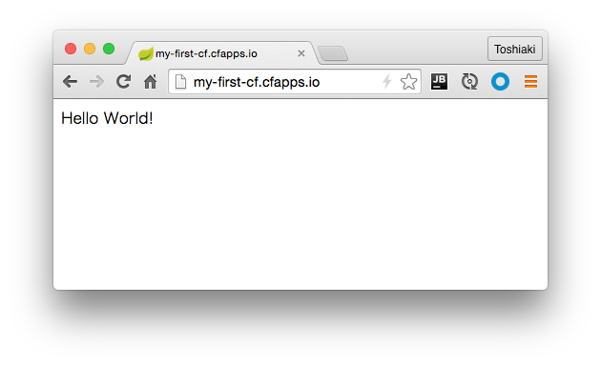

Slide 68
Database Access

Slide 69
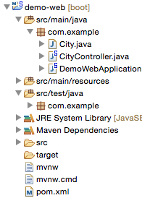
Add dependencies
Add
<dependency>
<groupId>org.springframework.boot</groupId>
<artifactId>spring-boot-starter-jdbc</artifactId>
</dependency>
<dependency>
<groupId>com.h2database</groupId>
<artifactId>h2</artifactId>
<scope>runtime</scope>
</dependency>

Slide 70
Use JdbcTemplate
@RestController
public class CityController {
@Autowired
JdbcTemplate jdbcTemplate;
@RequestMapping(value = "/cities", method = RequestMethod.GET)
List<City> getCities() {
return jdbcTemplate.query("SELECT id, name FROM city ORDER BY id", (rs, i) -> {
City city = new City();
city.setId(rs.getInt("id"));
city.setName(rs.getString("name"));
return city;
});
}
@RequestMapping(value = "/cities", method = RequestMethod.POST)
City postCities(@RequestBody City city) {
jdbcTemplate.update("INSERT INTO city(name) VALUES(?)", city.getName());
return city;
}
}

Slide 71
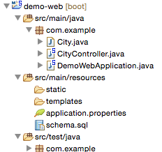
Create DDL file
Create schema.sql
CREATE TABLE city (
id INT PRIMARY KEY AUTO_INCREMENT,
name VARCHAR(255)
);

Slide 72
Re-Run & Access API (03-01)
. ____ _ __ _ _
/\\ / ___'_ __ _ _(_)_ __ __ _ \ \ \ \
( ( )\___ | '_ | '_| | '_ \/ _` | \ \ \ \
\\/ ___)| |_)| | | | | || (_| | ) ) ) )
' |____| .__|_| |_|_| |_\__, | / / / /
=========|_|==============|___/=/_/_/_/
:: Spring Boot :: (v1.3.2.RELEASE)
2016-02-03 16:06:29.588 INFO 38357 --- [ main] com.example.DemoWebApplication : Starting DemoWebApplication on jpxxmakitm1.corp.emc.com with PID 38357 (/Users/makit/demo/demo-web/target/classes started by makit in /Users/makit/demo/demo-web)
2016-02-03 16:06:29.591 INFO 38357 --- [ main] com.example.DemoWebApplication : No active profile set, falling back to default profiles: default
2016-02-03 16:06:29.637 INFO 38357 --- [ main] ationConfigEmbeddedWebApplicationContext : Refreshing org.springframework.boot.context.embedded.AnnotationConfigEmbeddedWebApplicationContext@68ceda24: startup date [Wed Feb 03 16:06:29 JST 2016]; root of context hierarchy
2016-02-03 16:06:30.158 INFO 38357 --- [ main] o.s.b.f.s.DefaultListableBeanFactory : Overriding bean definition for bean 'beanNameViewResolver' with a different definition: replacing [Root bean: class [null]; scope=; abstract=false; lazyInit=false; autowireMode=3; dependencyCheck=0; autowireCandidate=true; primary=false; factoryBeanName=org.springframework.boot.autoconfigure.web.ErrorMvcAutoConfiguration$WhitelabelErrorViewConfiguration; factoryMethodName=beanNameViewResolver; initMethodName=null; destroyMethodName=(inferred); defined in class path resource [org/springframework/boot/autoconfigure/web/ErrorMvcAutoConfiguration$WhitelabelErrorViewConfiguration.class]] with [Root bean: class [null]; scope=; abstract=false; lazyInit=false; autowireMode=3; dependencyCheck=0; autowireCandidate=true; primary=false; factoryBeanName=org.springframework.boot.autoconfigure.web.WebMvcAutoConfiguration$WebMvcAutoConfigurationAdapter; factoryMethodName=beanNameViewResolver; initMethodName=null; destroyMethodName=(inferred); defined in class path resource [org/springframework/boot/autoconfigure/web/WebMvcAutoConfiguration$WebMvcAutoConfigurationAdapter.class]]
2016-02-03 16:06:30.397 INFO 38357 --- [ main] trationDelegate$BeanPostProcessorChecker : Bean 'org.springframework.transaction.annotation.ProxyTransactionManagementConfiguration' of type [class org.springframework.transaction.annotation.ProxyTransactionManagementConfiguration$$EnhancerBySpringCGLIB$$1cbd89c5] is not eligible for getting processed by all BeanPostProcessors (for example: not eligible for auto-proxying)
2016-02-03 16:06:30.760 INFO 38357 --- [ main] s.b.c.e.t.TomcatEmbeddedServletContainer : Tomcat initialized with port(s): 8080 (http)
2016-02-03 16:06:30.772 INFO 38357 --- [ main] o.apache.catalina.core.StandardService : Starting service Tomcat
2016-02-03 16:06:30.773 INFO 38357 --- [ main] org.apache.catalina.core.StandardEngine : Starting Servlet Engine: Apache Tomcat/8.0.30
2016-02-03 16:06:30.849 INFO 38357 --- [ost-startStop-1] o.a.c.c.C.[Tomcat].[localhost].[/] : Initializing Spring embedded WebApplicationContext
2016-02-03 16:06:30.849 INFO 38357 --- [ost-startStop-1] o.s.web.context.ContextLoader : Root WebApplicationContext: initialization completed in 1215 ms
2016-02-03 16:06:31.083 INFO 38357 --- [ost-startStop-1] o.s.b.c.e.ServletRegistrationBean : Mapping servlet: 'dispatcherServlet' to [/]
2016-02-03 16:06:31.087 INFO 38357 --- [ost-startStop-1] o.s.b.c.embedded.FilterRegistrationBean : Mapping filter: 'characterEncodingFilter' to: [/*]
2016-02-03 16:06:31.088 INFO 38357 --- [ost-startStop-1] o.s.b.c.embedded.FilterRegistrationBean : Mapping filter: 'hiddenHttpMethodFilter' to: [/*]
2016-02-03 16:06:31.088 INFO 38357 --- [ost-startStop-1] o.s.b.c.embedded.FilterRegistrationBean : Mapping filter: 'httpPutFormContentFilter' to: [/*]
2016-02-03 16:06:31.088 INFO 38357 --- [ost-startStop-1] o.s.b.c.embedded.FilterRegistrationBean : Mapping filter: 'requestContextFilter' to: [/*]
2016-02-03 16:06:31.357 INFO 38357 --- [ main] o.s.jdbc.datasource.init.ScriptUtils : Executing SQL script from URL [file:/Users/makit/demo/demo-web/target/classes/schema.sql]
2016-02-03 16:06:31.367 INFO 38357 --- [ main] o.s.jdbc.datasource.init.ScriptUtils : Executed SQL script from URL [file:/Users/makit/demo/demo-web/target/classes/schema.sql] in 10 ms.
2016-02-03 16:06:31.564 INFO 38357 --- [ main] s.w.s.m.m.a.RequestMappingHandlerAdapter : Looking for @ControllerAdvice: org.springframework.boot.context.embedded.AnnotationConfigEmbeddedWebApplicationContext@68ceda24: startup date [Wed Feb 03 16:06:29 JST 2016]; root of context hierarchy
2016-02-03 16:06:31.617 INFO 38357 --- [ main] s.w.s.m.m.a.RequestMappingHandlerMapping : Mapped "{[/]}" onto java.lang.String com.example.DemoWebApplication.hello()
2016-02-03 16:06:31.619 INFO 38357 --- [ main] s.w.s.m.m.a.RequestMappingHandlerMapping : Mapped "{[/cities],methods=[GET]}" onto java.util.List<com.example.City> com.example.CityController.getCities()
2016-02-03 16:06:31.619 INFO 38357 --- [ main] s.w.s.m.m.a.RequestMappingHandlerMapping : Mapped "{[/cities],methods=[POST]}" onto com.example.City com.example.CityController.postCities(com.example.City)
2016-02-03 16:06:31.621 INFO 38357 --- [ main] s.w.s.m.m.a.RequestMappingHandlerMapping : Mapped "{[/error]}" onto public org.springframework.http.ResponseEntity<java.util.Map<java.lang.String, java.lang.Object>> org.springframework.boot.autoconfigure.web.BasicErrorController.error(javax.servlet.http.HttpServletRequest)
2016-02-03 16:06:31.621 INFO 38357 --- [ main] s.w.s.m.m.a.RequestMappingHandlerMapping : Mapped "{[/error],produces=[text/html]}" onto public org.springframework.web.servlet.ModelAndView org.springframework.boot.autoconfigure.web.BasicErrorController.errorHtml(javax.servlet.http.HttpServletRequest,javax.servlet.http.HttpServletResponse)
2016-02-03 16:06:31.644 INFO 38357 --- [ main] o.s.w.s.handler.SimpleUrlHandlerMapping : Mapped URL path [/webjars/**] onto handler of type [class org.springframework.web.servlet.resource.ResourceHttpRequestHandler]
2016-02-03 16:06:31.644 INFO 38357 --- [ main] o.s.w.s.handler.SimpleUrlHandlerMapping : Mapped URL path [/**] onto handler of type [class org.springframework.web.servlet.resource.ResourceHttpRequestHandler]
2016-02-03 16:06:31.681 INFO 38357 --- [ main] o.s.w.s.handler.SimpleUrlHandlerMapping : Mapped URL path [/**/favicon.ico] onto handler of type [class org.springframework.web.servlet.resource.ResourceHttpRequestHandler]
2016-02-03 16:06:31.848 INFO 38357 --- [ main] o.s.j.e.a.AnnotationMBeanExporter : Registering beans for JMX exposure on startup
2016-02-03 16:06:31.911 INFO 38357 --- [ main] s.b.c.e.t.TomcatEmbeddedServletContainer : Tomcat started on port(s): 8080 (http)
2016-02-03 16:06:31.915 INFO 38357 --- [ main] com.example.DemoWebApplication : Started DemoWebApplication in 2.572 seconds (JVM running for 2.871)

Slide 73
Re-Run & Access API (03-01)
$ curl -X GET http://localhost:8080/cities
[]
$ curl -X POST http://localhost:8080/cities -H "Content-Type: application/json" -d "{\"name\":\"Tokyo\"}"
{"id":null,"name":"Tokyo"}
$ curl -X POST http://localhost:8080/cities -H "Content-Type: application/json" -d "{\"name\":\"Osaka\"}"
{"id":null,"name":"Osaka"}
$ curl -X GET http://localhost:8080/cities
[{"id":1,"name":"Tokyo"},{"id":2,"name":"Osaka"}]

Slide 74
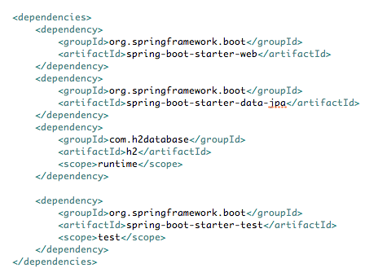
Use Spring Data JPA
<dependency>
<groupId>org.springframework.boot</groupId>
<artifactId>spring-boot-starter-data-jpa</artifactId>
</dependency>
Instead of
starter-jdbc

Slide 75
Create JPA's Entity
@Entity
public class City {
@Id
@GeneratedValue(strategy = GenerationType.IDENTITY)
private Integer id;
private String name;
public Integer getId() {
return id;
}
public void setId(Integer id) {
this.id = id;
}
public String getName() {
return name;
}
public void setName(String name) {
this.name = name;
}
}

Slide 76
Create Repository
package com.example;
import org.springframework.data.jpa.repository.JpaRepository;
public interface CityRepository extends JpaRepository<City, Integer> {
}

Slide 77
Use CityRepository
@RestController
public class CityController {
@Autowired
CityRepository cityRepository;
@RequestMapping(value = "/cities", method = RequestMethod.GET)
List<City> getCities() {
return cityRepository.findAll();
}
@RequestMapping(value = "/cities", method = RequestMethod.POST)
City postCities(@RequestBody City city) {
return cityRepository.save(city);
}
}

Slide 78
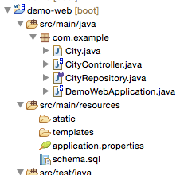
Remove DDL file
Remove schema.sql
JPA generates schema automatically

Slide 79
Re-Run (03-02)
. ____ _ __ _ _
/\\ / ___'_ __ _ _(_)_ __ __ _ \ \ \ \
( ( )\___ | '_ | '_| | '_ \/ _` | \ \ \ \
\\/ ___)| |_)| | | | | || (_| | ) ) ) )
' |____| .__|_| |_|_| |_\__, | / / / /
=========|_|==============|___/=/_/_/_/
:: Spring Boot :: (v1.3.2.RELEASE)
2016-02-03 16:04:18.599 INFO 38354 --- [ main] com.example.DemoWebApplication : Starting DemoWebApplication on jpxxmakitm1.corp.emc.com with PID 38354 (/Users/makit/demo/demo-web/target/classes started by makit in /Users/makit/demo/demo-web)
2016-02-03 16:04:18.602 INFO 38354 --- [ main] com.example.DemoWebApplication : No active profile set, falling back to default profiles: default
2016-02-03 16:04:18.653 INFO 38354 --- [ main] ationConfigEmbeddedWebApplicationContext : Refreshing org.springframework.boot.context.embedded.AnnotationConfigEmbeddedWebApplicationContext@543e710e: startup date [Wed Feb 03 16:04:18 JST 2016]; root of context hierarchy
2016-02-03 16:04:19.319 INFO 38354 --- [ main] o.s.b.f.s.DefaultListableBeanFactory : Overriding bean definition for bean 'beanNameViewResolver' with a different definition: replacing [Root bean: class [null]; scope=; abstract=false; lazyInit=false; autowireMode=3; dependencyCheck=0; autowireCandidate=true; primary=false; factoryBeanName=org.springframework.boot.autoconfigure.web.ErrorMvcAutoConfiguration$WhitelabelErrorViewConfiguration; factoryMethodName=beanNameViewResolver; initMethodName=null; destroyMethodName=(inferred); defined in class path resource [org/springframework/boot/autoconfigure/web/ErrorMvcAutoConfiguration$WhitelabelErrorViewConfiguration.class]] with [Root bean: class [null]; scope=; abstract=false; lazyInit=false; autowireMode=3; dependencyCheck=0; autowireCandidate=true; primary=false; factoryBeanName=org.springframework.boot.autoconfigure.web.WebMvcAutoConfiguration$WebMvcAutoConfigurationAdapter; factoryMethodName=beanNameViewResolver; initMethodName=null; destroyMethodName=(inferred); defined in class path resource [org/springframework/boot/autoconfigure/web/WebMvcAutoConfiguration$WebMvcAutoConfigurationAdapter.class]]
2016-02-03 16:04:19.678 INFO 38354 --- [ main] trationDelegate$BeanPostProcessorChecker : Bean 'org.springframework.transaction.annotation.ProxyTransactionManagementConfiguration' of type [class org.springframework.transaction.annotation.ProxyTransactionManagementConfiguration$$EnhancerBySpringCGLIB$$87f3551e] is not eligible for getting processed by all BeanPostProcessors (for example: not eligible for auto-proxying)
2016-02-03 16:04:20.074 INFO 38354 --- [ main] s.b.c.e.t.TomcatEmbeddedServletContainer : Tomcat initialized with port(s): 8080 (http)
2016-02-03 16:04:20.090 INFO 38354 --- [ main] o.apache.catalina.core.StandardService : Starting service Tomcat
2016-02-03 16:04:20.091 INFO 38354 --- [ main] org.apache.catalina.core.StandardEngine : Starting Servlet Engine: Apache Tomcat/8.0.30
2016-02-03 16:04:20.183 INFO 38354 --- [ost-startStop-1] o.a.c.c.C.[Tomcat].[localhost].[/] : Initializing Spring embedded WebApplicationContext
2016-02-03 16:04:20.183 INFO 38354 --- [ost-startStop-1] o.s.web.context.ContextLoader : Root WebApplicationContext: initialization completed in 1533 ms
2016-02-03 16:04:20.473 INFO 38354 --- [ost-startStop-1] o.s.b.c.e.ServletRegistrationBean : Mapping servlet: 'dispatcherServlet' to [/]
2016-02-03 16:04:20.477 INFO 38354 --- [ost-startStop-1] o.s.b.c.embedded.FilterRegistrationBean : Mapping filter: 'characterEncodingFilter' to: [/*]
2016-02-03 16:04:20.478 INFO 38354 --- [ost-startStop-1] o.s.b.c.embedded.FilterRegistrationBean : Mapping filter: 'hiddenHttpMethodFilter' to: [/*]
2016-02-03 16:04:20.478 INFO 38354 --- [ost-startStop-1] o.s.b.c.embedded.FilterRegistrationBean : Mapping filter: 'httpPutFormContentFilter' to: [/*]
2016-02-03 16:04:20.478 INFO 38354 --- [ost-startStop-1] o.s.b.c.embedded.FilterRegistrationBean : Mapping filter: 'requestContextFilter' to: [/*]
2016-02-03 16:04:20.860 INFO 38354 --- [ main] j.LocalContainerEntityManagerFactoryBean : Building JPA container EntityManagerFactory for persistence unit 'default'
2016-02-03 16:04:20.869 INFO 38354 --- [ main] o.hibernate.jpa.internal.util.LogHelper : HHH000204: Processing PersistenceUnitInfo [
name: default
...]
2016-02-03 16:04:20.929 INFO 38354 --- [ main] org.hibernate.Version : HHH000412: Hibernate Core {4.3.11.Final}
2016-02-03 16:04:20.931 INFO 38354 --- [ main] org.hibernate.cfg.Environment : HHH000206: hibernate.properties not found
2016-02-03 16:04:20.933 INFO 38354 --- [ main] org.hibernate.cfg.Environment : HHH000021: Bytecode provider name : javassist
2016-02-03 16:04:21.094 INFO 38354 --- [ main] o.hibernate.annotations.common.Version : HCANN000001: Hibernate Commons Annotations {4.0.5.Final}
2016-02-03 16:04:21.156 INFO 38354 --- [ main] org.hibernate.dialect.Dialect : HHH000400: Using dialect: org.hibernate.dialect.H2Dialect
2016-02-03 16:04:21.304 INFO 38354 --- [ main] o.h.h.i.ast.ASTQueryTranslatorFactory : HHH000397: Using ASTQueryTranslatorFactory
2016-02-03 16:04:21.472 INFO 38354 --- [ main] org.hibernate.tool.hbm2ddl.SchemaExport : HHH000227: Running hbm2ddl schema export
2016-02-03 16:04:21.478 INFO 38354 --- [ main] org.hibernate.tool.hbm2ddl.SchemaExport : HHH000230: Schema export complete
2016-02-03 16:04:21.809 INFO 38354 --- [ main] s.w.s.m.m.a.RequestMappingHandlerAdapter : Looking for @ControllerAdvice: org.springframework.boot.context.embedded.AnnotationConfigEmbeddedWebApplicationContext@543e710e: startup date [Wed Feb 03 16:04:18 JST 2016]; root of context hierarchy
2016-02-03 16:04:21.864 INFO 38354 --- [ main] s.w.s.m.m.a.RequestMappingHandlerMapping : Mapped "{[/]}" onto java.lang.String com.example.DemoWebApplication.hello()
2016-02-03 16:04:21.865 INFO 38354 --- [ main] s.w.s.m.m.a.RequestMappingHandlerMapping : Mapped "{[/cities],methods=[GET]}" onto java.util.List<com.example.City> com.example.CityController.getCities()
2016-02-03 16:04:21.866 INFO 38354 --- [ main] s.w.s.m.m.a.RequestMappingHandlerMapping : Mapped "{[/cities],methods=[POST]}" onto com.example.City com.example.CityController.postCities(com.example.City)
2016-02-03 16:04:21.869 INFO 38354 --- [ main] s.w.s.m.m.a.RequestMappingHandlerMapping : Mapped "{[/error]}" onto public org.springframework.http.ResponseEntity<java.util.Map<java.lang.String, java.lang.Object>> org.springframework.boot.autoconfigure.web.BasicErrorController.error(javax.servlet.http.HttpServletRequest)
2016-02-03 16:04:21.869 INFO 38354 --- [ main] s.w.s.m.m.a.RequestMappingHandlerMapping : Mapped "{[/error],produces=[text/html]}" onto public org.springframework.web.servlet.ModelAndView org.springframework.boot.autoconfigure.web.BasicErrorController.errorHtml(javax.servlet.http.HttpServletRequest,javax.servlet.http.HttpServletResponse)
2016-02-03 16:04:21.895 INFO 38354 --- [ main] o.s.w.s.handler.SimpleUrlHandlerMapping : Mapped URL path [/webjars/**] onto handler of type [class org.springframework.web.servlet.resource.ResourceHttpRequestHandler]
2016-02-03 16:04:21.895 INFO 38354 --- [ main] o.s.w.s.handler.SimpleUrlHandlerMapping : Mapped URL path [/**] onto handler of type [class org.springframework.web.servlet.resource.ResourceHttpRequestHandler]
2016-02-03 16:04:21.927 INFO 38354 --- [ main] o.s.w.s.handler.SimpleUrlHandlerMapping : Mapped URL path [/**/favicon.ico] onto handler of type [class org.springframework.web.servlet.resource.ResourceHttpRequestHandler]
2016-02-03 16:04:22.099 INFO 38354 --- [ main] o.s.j.e.a.AnnotationMBeanExporter : Registering beans for JMX exposure on startup
2016-02-03 16:04:22.164 INFO 38354 --- [ main] s.b.c.e.t.TomcatEmbeddedServletContainer : Tomcat started on port(s): 8080 (http)
2016-02-03 16:04:22.168 INFO 38354 --- [ main] com.example.DemoWebApplication : Started DemoWebApplication in 3.807 seconds (JVM running for 4.127)

Slide 80
Access API
$ curl -X GET http://localhost:8080/cities
[]
$ curl -X POST http://localhost:8080/cities -H "Content-Type: application/json" -d "{\"name\":\"Tokyo\"}"
{"id":1,"name":"Tokyo"}
$ curl -X POST http://localhost:8080/cities -H "Content-Type: application/json" -d "{\"name\":\"Osaka\"}"
{"id":2,"name":"Osaka"}
$ curl -X GET http://localhost:8080/cities
[{"id":1,"name":"Tokyo"},{"id":2,"name":"Osaka"}]

Slide 81
Push to Cloud Foundry with PostgreSQL
$ mvn clean package -Dmaven.test.skip=true
$ cf push my-second-cf -p target/demo-web-0.0.1-SNAPSHOT.jar --no-start
$ cf create-service elephantsql turtle demo-pg
$ cf bind-service my-second-cf demo-pg
$ cf set-env my-second-cf spring.jpa.hibernate.ddl-auto update
$ cf start my-second-cf

Slide 82
Push to Cloud Foundry with PostgreSQL
Starting app my-second-cf in org maki-org / space development as
...
Creating container
Successfully created container
Downloading app package...
Downloaded app package (23.3M)
Staging...
-----> Java Buildpack Version: v3.5.1 | http://github.com/pivotal-cf/pcf-java-buildpack.git#d6c19f8
-----> Downloading Open Jdk JRE 1.8.0_71 from https://download.run.pivotal.io/openjdk/trusty/x86_64/openjdk-1.8.0_71.tar.gz (1.0s)
Expanding Open Jdk JRE to .java-buildpack/open_jdk_jre (1.0s)
-----> Downloading Open JDK Like Memory Calculator 2.0.1_RELEASE from https://download.run.pivotal.io/memory-calculator/trusty/x86_64/memory-calculator-2.0.1_RELEASE.tar.gz (0.0s)
Memory Settings: -Xss1M -Xmx768M -XX:MaxMetaspaceSize=104857K -Xms768M -XX:MetaspaceSize=104857K
-----> Downloading Postgresql JDBC 9.4.1207 from https://download.run.pivotal.io/postgresql-jdbc/postgresql-jdbc-9.4.1207.jar (0.0s)
-----> Downloading Spring Auto Reconfiguration 1.10.0_RELEASE from https://download.run.pivotal.io/auto-reconfiguration/auto-reconfiguration-1.10.0_RELEASE.jar (0.0s)
Exit status 0
Staging complete
Uploading droplet, build artifacts cache...
Uploading droplet...
Uploading build artifacts cache...
Uploaded build artifacts cache (45.3M)
Uploaded droplet (68.8M)
Uploading complete

Slide 83
Push to Cloud Foundry with PostgreSQL
$ cf logs my-second-cf --recent
...
2016-02-03T17:34:59.78+0900 [APP/0] OUT . ____ _ __ _ _
2016-02-03T17:34:59.78+0900 [APP/0] OUT /\\ / ___'_ __ _ _(_)_ __ __ _ \ \ \ \
2016-02-03T17:34:59.78+0900 [APP/0] OUT ( ( )\___ | '_ | '_| | '_ \/ _` | \ \ \ \
2016-02-03T17:34:59.78+0900 [APP/0] OUT \\/ ___)| |_)| | | | | || (_| | ) ) ) )
2016-02-03T17:34:59.78+0900 [APP/0] OUT ' |____| .__|_| |_|_| |_\__, | / / / /
2016-02-03T17:34:59.78+0900 [APP/0] OUT =========|_|==============|___/=/_/_/_/
2016-02-03T17:34:59.78+0900 [APP/0] OUT :: Spring Boot :: (v1.3.2.RELEASE)
2016-02-03T17:34:59.97+0900 [APP/0] OUT 2016-02-03 08:34:59.969 INFO 17 --- [ main] pertySourceApplicationContextInitializer : Adding 'cloud' PropertySource to ApplicationContext
2016-02-03T17:35:00.04+0900 [APP/0] OUT 2016-02-03 08:35:00.048 INFO 17 --- [ main] nfigurationApplicationContextInitializer : Adding cloud service auto-reconfiguration to ApplicationContext
2016-02-03T17:35:00.06+0900 [APP/0] OUT 2016-02-03 08:35:00.062 INFO 17 --- [ main] com.example.DemoWebApplication : Starting DemoWebApplication on bqhqjki4du4 with PID 17 (/home/vcap/app started by vcap in /home/vcap/app)
2016-02-03T17:35:00.06+0900 [APP/0] OUT 2016-02-03 08:35:00.063 INFO 17 --- [ main] com.example.DemoWebApplication : The following profiles are active: cloud
2016-02-03T17:35:00.13+0900 [APP/0] OUT 2016-02-03 08:35:00.132 INFO 17 --- [ main] ationConfigEmbeddedWebApplicationContext : Refreshing org.springframework.boot.context.embedded.AnnotationConfigEmbeddedWebApplicationContext@5aff0582: startup date [Wed Feb 03 08:35:00 UTC 2016]; root of context hierarchy
2016-02-03T17:35:01.45+0900 [APP/0] OUT 2016-02-03 08:35:01.458 INFO 17 --- [ main] o.s.b.f.s.DefaultListableBeanFactory : Overriding bean definition for bean 'beanNameViewResolver' with a different definition: replacing [Root bean: class [null]; scope=; abstract=false; lazyInit=false; autowireMode=3; dependencyCheck=0; autowireCandidate=true; primary=false; factoryBeanName=org.springframework.boot.autoconfigure.web.ErrorMvcAutoConfiguration$WhitelabelErrorViewConfiguration; factoryMethodName=beanNameViewResolver; initMethodName=null; destroyMethodName=(inferred); defined in class path resource [org/springframework/boot/autoconfigure/web/ErrorMvcAutoConfiguration$WhitelabelErrorViewConfiguration.class]] with [Root bean: class [null]; scope=; abstract=false; lazyInit=false; autowireMode=3; dependencyCheck=0; autowireCandidate=true; primary=false; factoryBeanName=org.springframework.boot.autoconfigure.web.WebMvcAutoConfiguration$WebMvcAutoConfigurationAdapter; factoryMethodName=beanNameViewResolver; initMethodName=null; destroyMethodName=(inferred); defined in class path resource [org/springframework/boot/autoconfigure/web/WebMvcAutoConfiguration$WebMvcAutoConfigurationAdapter.class]]
2016-02-03T17:35:01.95+0900 [APP/0] OUT 2016-02-03 08:35:01.954 INFO 17 --- [ main] urceCloudServiceBeanFactoryPostProcessor : Auto-reconfiguring beans of type javax.sql.DataSource
2016-02-03T17:35:01.97+0900 [APP/0] OUT 2016-02-03 08:35:01.977 INFO 17 --- [ main] o.c.r.o.s.c.s.r.PooledDataSourceCreator : Found Tomcat high-performance connection pool on the classpath. Using it for DataSource connection pooling.
2016-02-03T17:35:02.02+0900 [APP/0] OUT 2016-02-03 08:35:02.017 INFO 17 --- [ main] urceCloudServiceBeanFactoryPostProcessor : Reconfigured bean dataSource into singleton service connector org.apache.tomcat.jdbc.pool.DataSource@5837583a{ConnectionPool[defaultAutoCommit=null; defaultReadOnly=null; defaultTransactionIsolation=-1; defaultCatalog=null; driverClassName=org.postgresql.Driver; maxActive=4; maxIdle=100; minIdle=0; initialSize=0; maxWait=30000; testOnBorrow=true; testOnReturn=false; timeBetweenEvictionRunsMillis=5000; numTestsPerEvictionRun=0; minEvictableIdleTimeMillis=60000; testWhileIdle=false; testOnConnect=false; password=********; url=jdbc:postgresql://pellefant-01.db.elephantsql.com:5432/qttknhee?user=qttknhee&password=3TPD1LUSPJF9PhxtRowA1kkn3gr0-dE3; username=null; validationQuery=SELECT 1; validationQueryTimeout=-1; validatorClassName=null; validationInterval=30000; accessToUnderlyingConnectionAllowed=true; removeAbandoned=false; removeAbandonedTimeout=60; logAbandoned=false; connectionProperties=null; initSQL=null; jdbcInterceptors=null; jmxEnabled=true; fairQueue=true; useEquals=true; abandonWhenPercentageFull=0; maxAge=0; useLock=false; dataSource=null; dataSourceJNDI=null; suspectTimeout=0; alternateUsernameAllowed=false; commitOnReturn=false; rollbackOnReturn=false; useDisposableConnectionFacade=true; logValidationErrors=false; propagateInterruptState=false; ignoreExceptionOnPreLoad=false; }
2016-02-03T17:35:02.02+0900 [APP/0] OUT 2016-02-03 08:35:02.020 INFO 17 --- [ main] nateCloudServiceBeanFactoryPostProcessor : Auto-reconfiguring beans of type org.springframework.orm.hibernate3.AbstractSessionFactoryBean
2016-02-03T17:35:02.02+0900 [APP/0] OUT 2016-02-03 08:35:02.022 INFO 17 --- [ main] nateCloudServiceBeanFactoryPostProcessor : Auto-reconfiguring beans of type org.springframework.orm.hibernate4.LocalSessionFactoryBean
2016-02-03T17:35:02.02+0900 [APP/0] OUT 2016-02-03 08:35:02.023 INFO 17 --- [ main] .JpaCloudServiceBeanFactoryPostProcessor : Auto-reconfiguring beans of type org.springframework.orm.jpa.AbstractEntityManagerFactoryBean
2016-02-03T17:35:02.20+0900 [APP/0] OUT 2016-02-03 08:35:02.204 INFO 17 --- [ main] trationDelegate$BeanPostProcessorChecker : Bean 'org.springframework.transaction.annotation.ProxyTransactionManagementConfiguration' of type [class org.springframework.transaction.annotation.ProxyTransactionManagementConfiguration$$EnhancerBySpringCGLIB$$15ea5add] is not eligible for getting processed by all BeanPostProcessors (for example: not eligible for auto-proxying)
2016-02-03T17:35:02.94+0900 [APP/0] OUT 2016-02-03 08:35:02.944 INFO 17 --- [ main] s.b.c.e.t.TomcatEmbeddedServletContainer : Tomcat initialized with port(s): 8080 (http)
2016-02-03T17:35:02.96+0900 [APP/0] OUT 2016-02-03 08:35:02.963 INFO 17 --- [ main] o.apache.catalina.core.StandardService : Starting service Tomcat
2016-02-03T17:35:02.96+0900 [APP/0] OUT 2016-02-03 08:35:02.965 INFO 17 --- [ main] org.apache.catalina.core.StandardEngine : Starting Servlet Engine: Apache Tomcat/8.0.30
2016-02-03T17:35:03.12+0900 [APP/0] OUT 2016-02-03 08:35:03.127 INFO 17 --- [ost-startStop-1] o.a.c.c.C.[Tomcat].[localhost].[/] : Initializing Spring embedded WebApplicationContext
2016-02-03T17:35:03.12+0900 [APP/0] OUT 2016-02-03 08:35:03.128 INFO 17 --- [ost-startStop-1] o.s.web.context.ContextLoader : Root WebApplicationContext: initialization completed in 3000 ms
2016-02-03T17:35:03.82+0900 [APP/0] OUT 2016-02-03 08:35:03.820 INFO 17 --- [ost-startStop-1] o.s.b.c.e.ServletRegistrationBean : Mapping servlet: 'dispatcherServlet' to [/]
2016-02-03T17:35:03.82+0900 [APP/0] OUT 2016-02-03 08:35:03.827 INFO 17 --- [ost-startStop-1] o.s.b.c.embedded.FilterRegistrationBean : Mapping filter: 'characterEncodingFilter' to: [/*]
2016-02-03T17:35:03.82+0900 [APP/0] OUT 2016-02-03 08:35:03.828 INFO 17 --- [ost-startStop-1] o.s.b.c.embedded.FilterRegistrationBean : Mapping filter: 'hiddenHttpMethodFilter' to: [/*]
2016-02-03T17:35:03.82+0900 [APP/0] OUT 2016-02-03 08:35:03.828 INFO 17 --- [ost-startStop-1] o.s.b.c.embedded.FilterRegistrationBean : Mapping filter: 'httpPutFormContentFilter' to: [/*]
2016-02-03T17:35:03.82+0900 [APP/0] OUT 2016-02-03 08:35:03.828 INFO 17 --- [ost-startStop-1] o.s.b.c.embedded.FilterRegistrationBean : Mapping filter: 'requestContextFilter' to: [/*]
2016-02-03T17:35:03.96+0900 [APP/0] OUT 2016-02-03 08:35:03.964 INFO 17 --- [ main] j.LocalContainerEntityManagerFactoryBean : Building JPA container EntityManagerFactory for persistence unit 'default'
2016-02-03T17:35:03.98+0900 [APP/0] OUT 2016-02-03 08:35:03.978 INFO 17 --- [ main] o.hibernate.jpa.internal.util.LogHelper : HHH000204: Processing PersistenceUnitInfo [
2016-02-03T17:35:03.98+0900 [APP/0] OUT name: default
2016-02-03T17:35:03.98+0900 [APP/0] OUT ...]
2016-02-03T17:35:04.15+0900 [APP/0] OUT 2016-02-03 08:35:04.154 INFO 17 --- [ main] org.hibernate.Version : HHH000412: Hibernate Core {4.3.11.Final}
2016-02-03T17:35:04.15+0900 [APP/0] OUT 2016-02-03 08:35:04.157 INFO 17 --- [ main] org.hibernate.cfg.Environment : HHH000206: hibernate.properties not found
2016-02-03T17:35:04.16+0900 [APP/0] OUT 2016-02-03 08:35:04.159 INFO 17 --- [ main] org.hibernate.cfg.Environment : HHH000021: Bytecode provider name : javassist
2016-02-03T17:35:04.51+0900 [APP/0] OUT 2016-02-03 08:35:04.510 INFO 17 --- [ main] o.hibernate.annotations.common.Version : HCANN000001: Hibernate Commons Annotations {4.0.5.Final}
2016-02-03T17:35:05.48+0900 [APP/0] OUT 2016-02-03 08:35:05.485 INFO 17 --- [ main] org.hibernate.dialect.Dialect : HHH000400: Using dialect: org.hibernate.dialect.PostgreSQLDialect
2016-02-03T17:35:05.50+0900 [APP/0] OUT 2016-02-03 08:35:05.508 INFO 17 --- [ main] o.h.e.jdbc.internal.LobCreatorBuilder : HHH000424: Disabling contextual LOB creation as createClob() method threw error : java.lang.reflect.InvocationTargetException
2016-02-03T17:35:05.66+0900 [APP/0] OUT 2016-02-03 08:35:05.662 INFO 17 --- [ main] o.h.h.i.ast.ASTQueryTranslatorFactory : HHH000397: Using ASTQueryTranslatorFactory
2016-02-03T17:35:05.99+0900 [APP/0] OUT 2016-02-03 08:35:05.990 INFO 17 --- [ main] org.hibernate.tool.hbm2ddl.SchemaUpdate : HHH000228: Running hbm2ddl schema update
2016-02-03T17:35:05.99+0900 [APP/0] OUT 2016-02-03 08:35:05.990 INFO 17 --- [ main] org.hibernate.tool.hbm2ddl.SchemaUpdate : HHH000102: Fetching database metadata
2016-02-03T17:35:05.99+0900 [APP/0] OUT 2016-02-03 08:35:05.996 INFO 17 --- [ main] org.hibernate.tool.hbm2ddl.SchemaUpdate : HHH000396: Updating schema
2016-02-03T17:35:06.00+0900 [APP/0] OUT 2016-02-03 08:35:06.007 INFO 17 --- [ main] java.sql.DatabaseMetaData : HHH000262: Table not found: city
2016-02-03T17:35:06.01+0900 [APP/0] OUT 2016-02-03 08:35:06.010 INFO 17 --- [ main] java.sql.DatabaseMetaData : HHH000262: Table not found: city
2016-02-03T17:35:06.01+0900 [APP/0] OUT 2016-02-03 08:35:06.012 INFO 17 --- [ main] java.sql.DatabaseMetaData : HHH000262: Table not found: city
2016-02-03T17:35:06.08+0900 [APP/0] OUT 2016-02-03 08:35:06.081 INFO 17 --- [ main] org.hibernate.tool.hbm2ddl.SchemaUpdate : HHH000232: Schema update complete
2016-02-03T17:35:06.72+0900 [APP/0] OUT 2016-02-03 08:35:06.725 INFO 17 --- [ main] s.w.s.m.m.a.RequestMappingHandlerAdapter : Looking for @ControllerAdvice: org.springframework.boot.context.embedded.AnnotationConfigEmbeddedWebApplicationContext@5aff0582: startup date [Wed Feb 03 08:35:00 UTC 2016]; root of context hierarchy
2016-02-03T17:35:06.83+0900 [APP/0] OUT 2016-02-03 08:35:06.833 INFO 17 --- [ main] s.w.s.m.m.a.RequestMappingHandlerMapping : Mapped "{[/]}" onto java.lang.String com.example.DemoWebApplication.hello()
2016-02-03T17:35:06.83+0900 [APP/0] OUT 2016-02-03 08:35:06.835 INFO 17 --- [ main] s.w.s.m.m.a.RequestMappingHandlerMapping : Mapped "{[/cities],methods=[GET]}" onto java.util.List<com.example.City> com.example.CityController.getCities()
2016-02-03T17:35:06.83+0900 [APP/0] OUT 2016-02-03 08:35:06.836 INFO 17 --- [ main] s.w.s.m.m.a.RequestMappingHandlerMapping : Mapped "{[/cities],methods=[POST]}" onto com.example.City com.example.CityController.postCities(com.example.City)
2016-02-03T17:35:06.83+0900 [APP/0] OUT 2016-02-03 08:35:06.839 INFO 17 --- [ main] s.w.s.m.m.a.RequestMappingHandlerMapping : Mapped "{[/error],produces=[text/html]}" onto public org.springframework.web.servlet.ModelAndView org.springframework.boot.autoconfigure.web.BasicErrorController.errorHtml(javax.servlet.http.HttpServletRequest,javax.servlet.http.HttpServletResponse)
2016-02-03T17:35:06.83+0900 [APP/0] OUT 2016-02-03 08:35:06.839 INFO 17 --- [ main] s.w.s.m.m.a.RequestMappingHandlerMapping : Mapped "{[/error]}" onto public org.springframework.http.ResponseEntity<java.util.Map<java.lang.String, java.lang.Object>> org.springframework.boot.autoconfigure.web.BasicErrorController.error(javax.servlet.http.HttpServletRequest)
2016-02-03T17:35:06.93+0900 [APP/0] OUT 2016-02-03 08:35:06.937 INFO 17 --- [ main] o.s.w.s.handler.SimpleUrlHandlerMapping : Mapped URL path [/webjars/**] onto handler of type [class org.springframework.web.servlet.resource.ResourceHttpRequestHandler]
2016-02-03T17:35:06.93+0900 [APP/0] OUT 2016-02-03 08:35:06.937 INFO 17 --- [ main] o.s.w.s.handler.SimpleUrlHandlerMapping : Mapped URL path [/**] onto handler of type [class org.springframework.web.servlet.resource.ResourceHttpRequestHandler]
2016-02-03T17:35:07.01+0900 [APP/0] OUT 2016-02-03 08:35:07.010 INFO 17 --- [ main] o.s.w.s.handler.SimpleUrlHandlerMapping : Mapped URL path [/**/favicon.ico] onto handler of type [class org.springframework.web.servlet.resource.ResourceHttpRequestHandler]
2016-02-03T17:35:07.42+0900 [APP/0] OUT 2016-02-03 08:35:07.420 INFO 17 --- [ main] o.s.j.e.a.AnnotationMBeanExporter : Registering beans for JMX exposure on startup
2016-02-03T17:35:07.50+0900 [CELL/0] OUT Container became healthy
2016-02-03T17:35:07.52+0900 [APP/0] OUT 2016-02-03 08:35:07.521 INFO 17 --- [ main] s.b.c.e.t.TomcatEmbeddedServletContainer : Tomcat started on port(s): 8080 (http)
2016-02-03T17:35:07.55+0900 [APP/0] OUT 2016-02-03 08:35:07.551 INFO 17 --- [ main] com.example.DemoWebApplication : Started DemoWebApplication in 8.646 seconds (JVM running for 9.327)

Slide 84
Access API
$ curl -X GET http://my-second-cf.cfapps.io/cities
[]
$ curl -X POST http://my-second-cf.cfapps.io/cities -H "Content-Type: application/json" -d "{\"name\":\"Tokyo\"}"
{"id":1,"name":"Tokyo"}
$ curl -X POST http://my-second-cf.cfapps.io/cities -H "Content-Type: application/json" -d "{\"name\":\"Osaka\"}"
{"id":2,"name":"Osaka"}
$ curl -X GET http://my-second-cf.cfapps.io/cities
[{"id":1,"name":"Tokyo"},{"id":2,"name":"Osaka"}]

Slide 85
Want to use schema.sql?
Disable JPA to generate schema
spring.jpa.hibernate.ddl-auto=none
# or validate
Use own schema.sql

Slide 86
Re-Run (03-03)
. ____ _ __ _ _
/\\ / ___'_ __ _ _(_)_ __ __ _ \ \ \ \
( ( )\___ | '_ | '_| | '_ \/ _` | \ \ \ \
\\/ ___)| |_)| | | | | || (_| | ) ) ) )
' |____| .__|_| |_|_| |_\__, | / / / /
=========|_|==============|___/=/_/_/_/
:: Spring Boot :: (v1.3.2.RELEASE)
2016-02-03 15:58:29.349 INFO 38161 --- [ main] com.example.DemoWebApplication : Starting DemoWebApplication on jpxxmakitm1.corp.emc.com with PID 38161 (/Users/makit/demo/demo-web/target/classes started by makit in /Users/makit/demo/demo-web)
2016-02-03 15:58:29.352 INFO 38161 --- [ main] com.example.DemoWebApplication : No active profile set, falling back to default profiles: default
2016-02-03 15:58:29.396 INFO 38161 --- [ main] ationConfigEmbeddedWebApplicationContext : Refreshing org.springframework.boot.context.embedded.AnnotationConfigEmbeddedWebApplicationContext@543e710e: startup date [Wed Feb 03 15:58:29 JST 2016]; root of context hierarchy
2016-02-03 15:58:29.974 INFO 38161 --- [ main] o.s.b.f.s.DefaultListableBeanFactory : Overriding bean definition for bean 'beanNameViewResolver' with a different definition: replacing [Root bean: class [null]; scope=; abstract=false; lazyInit=false; autowireMode=3; dependencyCheck=0; autowireCandidate=true; primary=false; factoryBeanName=org.springframework.boot.autoconfigure.web.ErrorMvcAutoConfiguration$WhitelabelErrorViewConfiguration; factoryMethodName=beanNameViewResolver; initMethodName=null; destroyMethodName=(inferred); defined in class path resource [org/springframework/boot/autoconfigure/web/ErrorMvcAutoConfiguration$WhitelabelErrorViewConfiguration.class]] with [Root bean: class [null]; scope=; abstract=false; lazyInit=false; autowireMode=3; dependencyCheck=0; autowireCandidate=true; primary=false; factoryBeanName=org.springframework.boot.autoconfigure.web.WebMvcAutoConfiguration$WebMvcAutoConfigurationAdapter; factoryMethodName=beanNameViewResolver; initMethodName=null; destroyMethodName=(inferred); defined in class path resource [org/springframework/boot/autoconfigure/web/WebMvcAutoConfiguration$WebMvcAutoConfigurationAdapter.class]]
2016-02-03 15:58:30.448 INFO 38161 --- [ main] trationDelegate$BeanPostProcessorChecker : Bean 'org.springframework.transaction.annotation.ProxyTransactionManagementConfiguration' of type [class org.springframework.transaction.annotation.ProxyTransactionManagementConfiguration$$EnhancerBySpringCGLIB$$a5b3d315] is not eligible for getting processed by all BeanPostProcessors (for example: not eligible for auto-proxying)
2016-02-03 15:58:30.873 INFO 38161 --- [ main] s.b.c.e.t.TomcatEmbeddedServletContainer : Tomcat initialized with port(s): 8080 (http)
2016-02-03 15:58:30.885 INFO 38161 --- [ main] o.apache.catalina.core.StandardService : Starting service Tomcat
2016-02-03 15:58:30.886 INFO 38161 --- [ main] org.apache.catalina.core.StandardEngine : Starting Servlet Engine: Apache Tomcat/8.0.30
2016-02-03 15:58:30.979 INFO 38161 --- [ost-startStop-1] o.a.c.c.C.[Tomcat].[localhost].[/] : Initializing Spring embedded WebApplicationContext
2016-02-03 15:58:30.979 INFO 38161 --- [ost-startStop-1] o.s.web.context.ContextLoader : Root WebApplicationContext: initialization completed in 1585 ms
2016-02-03 15:58:31.254 INFO 38161 --- [ost-startStop-1] o.s.b.c.e.ServletRegistrationBean : Mapping servlet: 'dispatcherServlet' to [/]
2016-02-03 15:58:31.257 INFO 38161 --- [ost-startStop-1] o.s.b.c.embedded.FilterRegistrationBean : Mapping filter: 'characterEncodingFilter' to: [/*]
2016-02-03 15:58:31.258 INFO 38161 --- [ost-startStop-1] o.s.b.c.embedded.FilterRegistrationBean : Mapping filter: 'hiddenHttpMethodFilter' to: [/*]
2016-02-03 15:58:31.258 INFO 38161 --- [ost-startStop-1] o.s.b.c.embedded.FilterRegistrationBean : Mapping filter: 'httpPutFormContentFilter' to: [/*]
2016-02-03 15:58:31.258 INFO 38161 --- [ost-startStop-1] o.s.b.c.embedded.FilterRegistrationBean : Mapping filter: 'requestContextFilter' to: [/*]
2016-02-03 15:58:31.565 INFO 38161 --- [ main] o.s.jdbc.datasource.init.ScriptUtils : Executing SQL script from URL [file:/Users/makit/demo/demo-web/target/classes/schema.sql]
2016-02-03 15:58:31.576 INFO 38161 --- [ main] o.s.jdbc.datasource.init.ScriptUtils : Executed SQL script from URL [file:/Users/makit/demo/demo-web/target/classes/schema.sql] in 11 ms.
2016-02-03 15:58:31.623 INFO 38161 --- [ main] j.LocalContainerEntityManagerFactoryBean : Building JPA container EntityManagerFactory for persistence unit 'default'
2016-02-03 15:58:31.634 INFO 38161 --- [ main] o.hibernate.jpa.internal.util.LogHelper : HHH000204: Processing PersistenceUnitInfo [
name: default
...]
2016-02-03 15:58:31.697 INFO 38161 --- [ main] org.hibernate.Version : HHH000412: Hibernate Core {4.3.11.Final}
2016-02-03 15:58:31.699 INFO 38161 --- [ main] org.hibernate.cfg.Environment : HHH000206: hibernate.properties not found
2016-02-03 15:58:31.701 INFO 38161 --- [ main] org.hibernate.cfg.Environment : HHH000021: Bytecode provider name : javassist
2016-02-03 15:58:31.883 INFO 38161 --- [ main] o.hibernate.annotations.common.Version : HCANN000001: Hibernate Commons Annotations {4.0.5.Final}
2016-02-03 15:58:31.955 INFO 38161 --- [ main] org.hibernate.dialect.Dialect : HHH000400: Using dialect: org.hibernate.dialect.H2Dialect
2016-02-03 15:58:32.117 INFO 38161 --- [ main] o.h.h.i.ast.ASTQueryTranslatorFactory : HHH000397: Using ASTQueryTranslatorFactory
2016-02-03 15:58:32.606 INFO 38161 --- [ main] s.w.s.m.m.a.RequestMappingHandlerAdapter : Looking for @ControllerAdvice: org.springframework.boot.context.embedded.AnnotationConfigEmbeddedWebApplicationContext@543e710e: startup date [Wed Feb 03 15:58:29 JST 2016]; root of context hierarchy
2016-02-03 15:58:32.662 INFO 38161 --- [ main] s.w.s.m.m.a.RequestMappingHandlerMapping : Mapped "{[/]}" onto java.lang.String com.example.DemoWebApplication.hello()
2016-02-03 15:58:32.663 INFO 38161 --- [ main] s.w.s.m.m.a.RequestMappingHandlerMapping : Mapped "{[/cities],methods=[GET]}" onto java.util.List<com.example.City> com.example.CityController.getCities()
2016-02-03 15:58:32.663 INFO 38161 --- [ main] s.w.s.m.m.a.RequestMappingHandlerMapping : Mapped "{[/cities],methods=[POST]}" onto com.example.City com.example.CityController.postCities(com.example.City)
2016-02-03 15:58:32.665 INFO 38161 --- [ main] s.w.s.m.m.a.RequestMappingHandlerMapping : Mapped "{[/error]}" onto public org.springframework.http.ResponseEntity<java.util.Map<java.lang.String, java.lang.Object>> org.springframework.boot.autoconfigure.web.BasicErrorController.error(javax.servlet.http.HttpServletRequest)
2016-02-03 15:58:32.665 INFO 38161 --- [ main] s.w.s.m.m.a.RequestMappingHandlerMapping : Mapped "{[/error],produces=[text/html]}" onto public org.springframework.web.servlet.ModelAndView org.springframework.boot.autoconfigure.web.BasicErrorController.errorHtml(javax.servlet.http.HttpServletRequest,javax.servlet.http.HttpServletResponse)
2016-02-03 15:58:32.687 INFO 38161 --- [ main] o.s.w.s.handler.SimpleUrlHandlerMapping : Mapped URL path [/webjars/**] onto handler of type [class org.springframework.web.servlet.resource.ResourceHttpRequestHandler]
2016-02-03 15:58:32.687 INFO 38161 --- [ main] o.s.w.s.handler.SimpleUrlHandlerMapping : Mapped URL path [/**] onto handler of type [class org.springframework.web.servlet.resource.ResourceHttpRequestHandler]
2016-02-03 15:58:32.715 INFO 38161 --- [ main] o.s.w.s.handler.SimpleUrlHandlerMapping : Mapped URL path [/**/favicon.ico] onto handler of type [class org.springframework.web.servlet.resource.ResourceHttpRequestHandler]
2016-02-03 15:58:32.885 INFO 38161 --- [ main] o.s.j.e.a.AnnotationMBeanExporter : Registering beans for JMX exposure on startup
2016-02-03 15:58:32.947 INFO 38161 --- [ main] s.b.c.e.t.TomcatEmbeddedServletContainer : Tomcat started on port(s): 8080 (http)
2016-02-03 15:58:32.951 INFO 38161 --- [ main] com.example.DemoWebApplication : Started DemoWebApplication in 4.188 seconds (JVM running for 4.507)

Slide 87
Access API
$ curl -X GET http://localhost:8080/cities
[]
$ curl -X POST http://localhost:8080/cities -H "Content-Type: application/json" -d "{\"name\":\"Tokyo\"}"
{"id":1,"name":"Tokyo"}
$ curl -X POST http://localhost:8080/cities -H "Content-Type: application/json" -d "{\"name\":\"Osaka\"}"
{"id":2,"name":"Osaka"}
$ curl -X GET http://localhost:8080/cities
[{"id":1,"name":"Tokyo"},{"id":2,"name":"Osaka"}]

Slide 88
Add Spring Data REST
<dependency>
<groupId>org.springframework.boot</groupId>
<artifactId>spring-boot-starter-data-rest</artifactId>
</dependency>

Slide 89
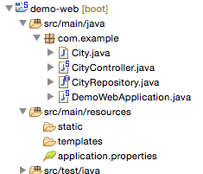
Delete CityController
No longer needed

Slide 90
Add @RepositoryRestResource
package com.example;
import org.springframework.data.jpa.repository.JpaRepository;
import org.springframework.data.rest.core.annotation.RepositoryRestResource;
@RepositoryRestResource
public interface CityRepository extends JpaRepository<City, Integer> {
}

Slide 91
Re-Run (03-04)
. ____ _ __ _ _
/\\ / ___'_ __ _ _(_)_ __ __ _ \ \ \ \
( ( )\___ | '_ | '_| | '_ \/ _` | \ \ \ \
\\/ ___)| |_)| | | | | || (_| | ) ) ) )
' |____| .__|_| |_|_| |_\__, | / / / /
=========|_|==============|___/=/_/_/_/
:: Spring Boot :: (v1.3.2.RELEASE)
2016-02-04 15:06:43.843 INFO 52949 --- [ main] com.example.DemoWebApplication : Starting DemoWebApplication on jpxxmakitm1.corp.emc.com with PID 52949 (/Users/makit/demo/demo-web/target/classes started by makit in /Users/makit/demo/demo-web)
2016-02-04 15:06:43.846 INFO 52949 --- [ main] com.example.DemoWebApplication : No active profile set, falling back to default profiles: default
2016-02-04 15:06:43.901 INFO 52949 --- [ main] ationConfigEmbeddedWebApplicationContext : Refreshing org.springframework.boot.context.embedded.AnnotationConfigEmbeddedWebApplicationContext@2473b9ce: startup date [Thu Feb 04 15:06:43 JST 2016]; root of context hierarchy
2016-02-04 15:06:44.646 INFO 52949 --- [ main] o.s.b.f.s.DefaultListableBeanFactory : Overriding bean definition for bean 'beanNameViewResolver' with a different definition: replacing [Root bean: class [null]; scope=; abstract=false; lazyInit=false; autowireMode=3; dependencyCheck=0; autowireCandidate=true; primary=false; factoryBeanName=org.springframework.boot.autoconfigure.web.ErrorMvcAutoConfiguration$WhitelabelErrorViewConfiguration; factoryMethodName=beanNameViewResolver; initMethodName=null; destroyMethodName=(inferred); defined in class path resource [org/springframework/boot/autoconfigure/web/ErrorMvcAutoConfiguration$WhitelabelErrorViewConfiguration.class]] with [Root bean: class [null]; scope=; abstract=false; lazyInit=false; autowireMode=3; dependencyCheck=0; autowireCandidate=true; primary=false; factoryBeanName=org.springframework.boot.autoconfigure.web.WebMvcAutoConfiguration$WebMvcAutoConfigurationAdapter; factoryMethodName=beanNameViewResolver; initMethodName=null; destroyMethodName=(inferred); defined in class path resource [org/springframework/boot/autoconfigure/web/WebMvcAutoConfiguration$WebMvcAutoConfigurationAdapter.class]]
2016-02-04 15:06:45.226 INFO 52949 --- [ main] trationDelegate$BeanPostProcessorChecker : Bean 'org.springframework.transaction.annotation.ProxyTransactionManagementConfiguration' of type [class org.springframework.transaction.annotation.ProxyTransactionManagementConfiguration$$EnhancerBySpringCGLIB$$9e6ad1ec] is not eligible for getting processed by all BeanPostProcessors (for example: not eligible for auto-proxying)
2016-02-04 15:06:45.689 INFO 52949 --- [ main] s.b.c.e.t.TomcatEmbeddedServletContainer : Tomcat initialized with port(s): 8080 (http)
2016-02-04 15:06:45.708 INFO 52949 --- [ main] o.apache.catalina.core.StandardService : Starting service Tomcat
2016-02-04 15:06:45.709 INFO 52949 --- [ main] org.apache.catalina.core.StandardEngine : Starting Servlet Engine: Apache Tomcat/8.0.30
2016-02-04 15:06:45.875 INFO 52949 --- [ost-startStop-1] o.a.c.c.C.[Tomcat].[localhost].[/] : Initializing Spring embedded WebApplicationContext
2016-02-04 15:06:45.876 INFO 52949 --- [ost-startStop-1] o.s.web.context.ContextLoader : Root WebApplicationContext: initialization completed in 1976 ms
2016-02-04 15:06:46.676 INFO 52949 --- [ost-startStop-1] j.LocalContainerEntityManagerFactoryBean : Building JPA container EntityManagerFactory for persistence unit 'default'
2016-02-04 15:06:46.689 INFO 52949 --- [ost-startStop-1] o.hibernate.jpa.internal.util.LogHelper : HHH000204: Processing PersistenceUnitInfo [
name: default
...]
2016-02-04 15:06:46.783 INFO 52949 --- [ost-startStop-1] org.hibernate.Version : HHH000412: Hibernate Core {4.3.11.Final}
2016-02-04 15:06:46.785 INFO 52949 --- [ost-startStop-1] org.hibernate.cfg.Environment : HHH000206: hibernate.properties not found
2016-02-04 15:06:46.788 INFO 52949 --- [ost-startStop-1] org.hibernate.cfg.Environment : HHH000021: Bytecode provider name : javassist
2016-02-04 15:06:47.006 INFO 52949 --- [ost-startStop-1] o.hibernate.annotations.common.Version : HCANN000001: Hibernate Commons Annotations {4.0.5.Final}
2016-02-04 15:06:47.092 INFO 52949 --- [ost-startStop-1] org.hibernate.dialect.Dialect : HHH000400: Using dialect: org.hibernate.dialect.H2Dialect
2016-02-04 15:06:47.277 INFO 52949 --- [ost-startStop-1] o.h.h.i.ast.ASTQueryTranslatorFactory : HHH000397: Using ASTQueryTranslatorFactory
2016-02-04 15:06:47.513 INFO 52949 --- [ost-startStop-1] org.hibernate.tool.hbm2ddl.SchemaExport : HHH000227: Running hbm2ddl schema export
2016-02-04 15:06:47.521 INFO 52949 --- [ost-startStop-1] org.hibernate.tool.hbm2ddl.SchemaExport : HHH000230: Schema export complete
2016-02-04 15:06:47.719 INFO 52949 --- [ost-startStop-1] o.s.b.f.config.PropertiesFactoryBean : Loading properties file from class path resource [rest-default-messages.properties]
2016-02-04 15:06:47.941 INFO 52949 --- [ost-startStop-1] o.s.b.c.e.ServletRegistrationBean : Mapping servlet: 'dispatcherServlet' to [/]
2016-02-04 15:06:47.945 INFO 52949 --- [ost-startStop-1] o.s.b.c.embedded.FilterRegistrationBean : Mapping filter: 'characterEncodingFilter' to: [/*]
2016-02-04 15:06:47.945 INFO 52949 --- [ost-startStop-1] o.s.b.c.embedded.FilterRegistrationBean : Mapping filter: 'hiddenHttpMethodFilter' to: [/*]
2016-02-04 15:06:47.946 INFO 52949 --- [ost-startStop-1] o.s.b.c.embedded.FilterRegistrationBean : Mapping filter: 'httpPutFormContentFilter' to: [/*]
2016-02-04 15:06:47.946 INFO 52949 --- [ost-startStop-1] o.s.b.c.embedded.FilterRegistrationBean : Mapping filter: 'requestContextFilter' to: [/*]
2016-02-04 15:06:48.219 INFO 52949 --- [ main] s.w.s.m.m.a.RequestMappingHandlerAdapter : Looking for @ControllerAdvice: org.springframework.boot.context.embedded.AnnotationConfigEmbeddedWebApplicationContext@2473b9ce: startup date [Thu Feb 04 15:06:43 JST 2016]; root of context hierarchy
2016-02-04 15:06:48.302 INFO 52949 --- [ main] s.w.s.m.m.a.RequestMappingHandlerMapping : Mapped "{[/]}" onto java.lang.String com.example.DemoWebApplication.hello()
2016-02-04 15:06:48.306 INFO 52949 --- [ main] s.w.s.m.m.a.RequestMappingHandlerMapping : Mapped "{[/error]}" onto public org.springframework.http.ResponseEntity<java.util.Map<java.lang.String, java.lang.Object>> org.springframework.boot.autoconfigure.web.BasicErrorController.error(javax.servlet.http.HttpServletRequest)
2016-02-04 15:06:48.306 INFO 52949 --- [ main] s.w.s.m.m.a.RequestMappingHandlerMapping : Mapped "{[/error],produces=[text/html]}" onto public org.springframework.web.servlet.ModelAndView org.springframework.boot.autoconfigure.web.BasicErrorController.errorHtml(javax.servlet.http.HttpServletRequest,javax.servlet.http.HttpServletResponse)
2016-02-04 15:06:48.333 INFO 52949 --- [ main] o.s.w.s.handler.SimpleUrlHandlerMapping : Mapped URL path [/webjars/**] onto handler of type [class org.springframework.web.servlet.resource.ResourceHttpRequestHandler]
2016-02-04 15:06:48.333 INFO 52949 --- [ main] o.s.w.s.handler.SimpleUrlHandlerMapping : Mapped URL path [/**] onto handler of type [class org.springframework.web.servlet.resource.ResourceHttpRequestHandler]
2016-02-04 15:06:48.348 INFO 52949 --- [ main] .m.m.a.ExceptionHandlerExceptionResolver : Detected @ExceptionHandler methods in repositoryRestExceptionHandler
2016-02-04 15:06:48.367 INFO 52949 --- [ main] o.s.w.s.handler.SimpleUrlHandlerMapping : Mapped URL path [/**/favicon.ico] onto handler of type [class org.springframework.web.servlet.resource.ResourceHttpRequestHandler]
2016-02-04 15:06:48.537 INFO 52949 --- [ main] o.s.d.r.w.RepositoryRestHandlerAdapter : Looking for @ControllerAdvice: org.springframework.boot.context.embedded.AnnotationConfigEmbeddedWebApplicationContext@2473b9ce: startup date [Thu Feb 04 15:06:43 JST 2016]; root of context hierarchy
2016-02-04 15:06:48.551 INFO 52949 --- [ main] o.s.d.r.w.RepositoryRestHandlerMapping : Mapped "{[/{repository}/{id}/{property}],methods=[GET],produces=[application/hal+json || application/json || application/*+json;charset=UTF-8]}" onto public org.springframework.http.ResponseEntity<org.springframework.hateoas.ResourceSupport> org.springframework.data.rest.webmvc.RepositoryPropertyReferenceController.followPropertyReference(org.springframework.data.rest.webmvc.RootResourceInformation,java.io.Serializable,java.lang.String,org.springframework.data.rest.webmvc.PersistentEntityResourceAssembler) throws java.lang.Exception
2016-02-04 15:06:48.551 INFO 52949 --- [ main] o.s.d.r.w.RepositoryRestHandlerMapping : Mapped "{[/{repository}/{id}/{property}/{propertyId}],methods=[GET],produces=[application/hal+json || application/json || application/*+json;charset=UTF-8]}" onto public org.springframework.http.ResponseEntity<org.springframework.hateoas.ResourceSupport> org.springframework.data.rest.webmvc.RepositoryPropertyReferenceController.followPropertyReference(org.springframework.data.rest.webmvc.RootResourceInformation,java.io.Serializable,java.lang.String,java.lang.String,org.springframework.data.rest.webmvc.PersistentEntityResourceAssembler) throws java.lang.Exception
2016-02-04 15:06:48.552 INFO 52949 --- [ main] o.s.d.r.w.RepositoryRestHandlerMapping : Mapped "{[/{repository}/{id}/{property}],methods=[DELETE],produces=[application/hal+json || application/json || application/*+json;charset=UTF-8]}" onto public org.springframework.http.ResponseEntity<? extends org.springframework.hateoas.ResourceSupport> org.springframework.data.rest.webmvc.RepositoryPropertyReferenceController.deletePropertyReference(org.springframework.data.rest.webmvc.RootResourceInformation,java.io.Serializable,java.lang.String) throws java.lang.Exception
2016-02-04 15:06:48.552 INFO 52949 --- [ main] o.s.d.r.w.RepositoryRestHandlerMapping : Mapped "{[/{repository}/{id}/{property}],methods=[GET],produces=[application/x-spring-data-compact+json || text/uri-list]}" onto public org.springframework.http.ResponseEntity<org.springframework.hateoas.ResourceSupport> org.springframework.data.rest.webmvc.RepositoryPropertyReferenceController.followPropertyReferenceCompact(org.springframework.data.rest.webmvc.RootResourceInformation,java.io.Serializable,java.lang.String,org.springframework.data.rest.webmvc.PersistentEntityResourceAssembler) throws java.lang.Exception
2016-02-04 15:06:48.552 INFO 52949 --- [ main] o.s.d.r.w.RepositoryRestHandlerMapping : Mapped "{[/{repository}/{id}/{property}],methods=[PATCH || PUT || POST],consumes=[application/json || application/x-spring-data-compact+json || text/uri-list],produces=[application/hal+json || application/json || application/*+json;charset=UTF-8]}" onto public org.springframework.http.ResponseEntity<? extends org.springframework.hateoas.ResourceSupport> org.springframework.data.rest.webmvc.RepositoryPropertyReferenceController.createPropertyReference(org.springframework.data.rest.webmvc.RootResourceInformation,org.springframework.http.HttpMethod,org.springframework.hateoas.Resources<java.lang.Object>,java.io.Serializable,java.lang.String) throws java.lang.Exception
2016-02-04 15:06:48.553 INFO 52949 --- [ main] o.s.d.r.w.RepositoryRestHandlerMapping : Mapped "{[/{repository}/{id}/{property}/{propertyId}],methods=[DELETE],produces=[application/hal+json || application/json || application/*+json;charset=UTF-8]}" onto public org.springframework.http.ResponseEntity<org.springframework.hateoas.ResourceSupport> org.springframework.data.rest.webmvc.RepositoryPropertyReferenceController.deletePropertyReferenceId(org.springframework.data.rest.webmvc.RootResourceInformation,java.io.Serializable,java.lang.String,java.lang.String) throws java.lang.Exception
2016-02-04 15:06:48.558 INFO 52949 --- [ main] o.s.d.r.w.RepositoryRestHandlerMapping : Mapped "{[/{repository}],methods=[OPTIONS],produces=[application/hal+json || application/json || application/*+json;charset=UTF-8]}" onto public org.springframework.http.ResponseEntity<?> org.springframework.data.rest.webmvc.RepositoryEntityController.optionsForCollectionResource(org.springframework.data.rest.webmvc.RootResourceInformation)
2016-02-04 15:06:48.558 INFO 52949 --- [ main] o.s.d.r.w.RepositoryRestHandlerMapping : Mapped "{[/{repository}],methods=[HEAD],produces=[application/hal+json || application/json || application/*+json;charset=UTF-8]}" onto public org.springframework.http.ResponseEntity<?> org.springframework.data.rest.webmvc.RepositoryEntityController.headCollectionResource(org.springframework.data.rest.webmvc.RootResourceInformation,org.springframework.data.rest.webmvc.support.DefaultedPageable) throws org.springframework.web.HttpRequestMethodNotSupportedException
2016-02-04 15:06:48.558 INFO 52949 --- [ main] o.s.d.r.w.RepositoryRestHandlerMapping : Mapped "{[/{repository}],methods=[GET],produces=[application/hal+json || application/json || application/*+json;charset=UTF-8]}" onto public org.springframework.hateoas.Resources<?> org.springframework.data.rest.webmvc.RepositoryEntityController.getCollectionResource(org.springframework.data.rest.webmvc.RootResourceInformation,org.springframework.data.rest.webmvc.support.DefaultedPageable,org.springframework.data.domain.Sort,org.springframework.data.rest.webmvc.PersistentEntityResourceAssembler) throws org.springframework.data.rest.webmvc.ResourceNotFoundException,org.springframework.web.HttpRequestMethodNotSupportedException
2016-02-04 15:06:48.558 INFO 52949 --- [ main] o.s.d.r.w.RepositoryRestHandlerMapping : Mapped "{[/{repository}],methods=[GET],produces=[application/x-spring-data-compact+json || text/uri-list]}" onto public org.springframework.hateoas.Resources<?> org.springframework.data.rest.webmvc.RepositoryEntityController.getCollectionResourceCompact(org.springframework.data.rest.webmvc.RootResourceInformation,org.springframework.data.rest.webmvc.support.DefaultedPageable,org.springframework.data.domain.Sort,org.springframework.data.rest.webmvc.PersistentEntityResourceAssembler) throws org.springframework.data.rest.webmvc.ResourceNotFoundException,org.springframework.web.HttpRequestMethodNotSupportedException
2016-02-04 15:06:48.559 INFO 52949 --- [ main] o.s.d.r.w.RepositoryRestHandlerMapping : Mapped "{[/{repository}],methods=[POST],produces=[application/hal+json || application/json || application/*+json;charset=UTF-8]}" onto public org.springframework.http.ResponseEntity<org.springframework.hateoas.ResourceSupport> org.springframework.data.rest.webmvc.RepositoryEntityController.postCollectionResource(org.springframework.data.rest.webmvc.RootResourceInformation,org.springframework.data.rest.webmvc.PersistentEntityResource,org.springframework.data.rest.webmvc.PersistentEntityResourceAssembler,java.lang.String) throws org.springframework.web.HttpRequestMethodNotSupportedException
2016-02-04 15:06:48.559 INFO 52949 --- [ main] o.s.d.r.w.RepositoryRestHandlerMapping : Mapped "{[/{repository}/{id}],methods=[OPTIONS],produces=[application/hal+json || application/json || application/*+json;charset=UTF-8]}" onto public org.springframework.http.ResponseEntity<?> org.springframework.data.rest.webmvc.RepositoryEntityController.optionsForItemResource(org.springframework.data.rest.webmvc.RootResourceInformation)
2016-02-04 15:06:48.559 INFO 52949 --- [ main] o.s.d.r.w.RepositoryRestHandlerMapping : Mapped "{[/{repository}/{id}],methods=[HEAD],produces=[application/hal+json || application/json || application/*+json;charset=UTF-8]}" onto public org.springframework.http.ResponseEntity<?> org.springframework.data.rest.webmvc.RepositoryEntityController.headForItemResource(org.springframework.data.rest.webmvc.RootResourceInformation,java.io.Serializable,org.springframework.data.rest.webmvc.PersistentEntityResourceAssembler) throws org.springframework.web.HttpRequestMethodNotSupportedException
2016-02-04 15:06:48.559 INFO 52949 --- [ main] o.s.d.r.w.RepositoryRestHandlerMapping : Mapped "{[/{repository}/{id}],methods=[GET],produces=[application/hal+json || application/json || application/*+json;charset=UTF-8]}" onto public org.springframework.http.ResponseEntity<org.springframework.hateoas.Resource<?>> org.springframework.data.rest.webmvc.RepositoryEntityController.getItemResource(org.springframework.data.rest.webmvc.RootResourceInformation,java.io.Serializable,org.springframework.data.rest.webmvc.PersistentEntityResourceAssembler,org.springframework.util.MultiValueMap<java.lang.String, java.lang.String>) throws org.springframework.web.HttpRequestMethodNotSupportedException
2016-02-04 15:06:48.560 INFO 52949 --- [ main] o.s.d.r.w.RepositoryRestHandlerMapping : Mapped "{[/{repository}/{id}],methods=[PUT],produces=[application/hal+json || application/json || application/*+json;charset=UTF-8]}" onto public org.springframework.http.ResponseEntity<? extends org.springframework.hateoas.ResourceSupport> org.springframework.data.rest.webmvc.RepositoryEntityController.putItemResource(org.springframework.data.rest.webmvc.RootResourceInformation,org.springframework.data.rest.webmvc.PersistentEntityResource,java.io.Serializable,org.springframework.data.rest.webmvc.PersistentEntityResourceAssembler,org.springframework.data.rest.webmvc.support.ETag,java.lang.String) throws org.springframework.web.HttpRequestMethodNotSupportedException
2016-02-04 15:06:48.560 INFO 52949 --- [ main] o.s.d.r.w.RepositoryRestHandlerMapping : Mapped "{[/{repository}/{id}],methods=[PATCH],produces=[application/hal+json || application/json || application/*+json;charset=UTF-8]}" onto public org.springframework.http.ResponseEntity<org.springframework.hateoas.ResourceSupport> org.springframework.data.rest.webmvc.RepositoryEntityController.patchItemResource(org.springframework.data.rest.webmvc.RootResourceInformation,org.springframework.data.rest.webmvc.PersistentEntityResource,java.io.Serializable,org.springframework.data.rest.webmvc.PersistentEntityResourceAssembler,org.springframework.data.rest.webmvc.support.ETag,java.lang.String) throws org.springframework.web.HttpRequestMethodNotSupportedException,org.springframework.data.rest.webmvc.ResourceNotFoundException
2016-02-04 15:06:48.560 INFO 52949 --- [ main] o.s.d.r.w.RepositoryRestHandlerMapping : Mapped "{[/{repository}/{id}],methods=[DELETE],produces=[application/hal+json || application/json || application/*+json;charset=UTF-8]}" onto public org.springframework.http.ResponseEntity<?> org.springframework.data.rest.webmvc.RepositoryEntityController.deleteItemResource(org.springframework.data.rest.webmvc.RootResourceInformation,java.io.Serializable,org.springframework.data.rest.webmvc.support.ETag) throws org.springframework.data.rest.webmvc.ResourceNotFoundException,org.springframework.web.HttpRequestMethodNotSupportedException
2016-02-04 15:06:48.562 INFO 52949 --- [ main] o.s.d.r.w.RepositoryRestHandlerMapping : Mapped "{[/ || ],methods=[OPTIONS],produces=[application/hal+json || application/json || application/*+json;charset=UTF-8]}" onto public org.springframework.http.HttpEntity<?> org.springframework.data.rest.webmvc.RepositoryController.optionsForRepositories()
2016-02-04 15:06:48.562 INFO 52949 --- [ main] o.s.d.r.w.RepositoryRestHandlerMapping : Mapped "{[/ || ],methods=[HEAD],produces=[application/hal+json || application/json || application/*+json;charset=UTF-8]}" onto public org.springframework.http.ResponseEntity<?> org.springframework.data.rest.webmvc.RepositoryController.headForRepositories()
2016-02-04 15:06:48.563 INFO 52949 --- [ main] o.s.d.r.w.RepositoryRestHandlerMapping : Mapped "{[/ || ],methods=[GET],produces=[application/hal+json || application/json || application/*+json;charset=UTF-8]}" onto public org.springframework.http.HttpEntity<org.springframework.data.rest.webmvc.RepositoryLinksResource> org.springframework.data.rest.webmvc.RepositoryController.listRepositories()
2016-02-04 15:06:48.564 INFO 52949 --- [ main] o.s.d.r.w.RepositoryRestHandlerMapping : Mapped "{[/{repository}/search],methods=[HEAD],produces=[application/hal+json || application/json || application/*+json;charset=UTF-8]}" onto public org.springframework.http.HttpEntity<?> org.springframework.data.rest.webmvc.RepositorySearchController.headForSearches(org.springframework.data.rest.webmvc.RootResourceInformation)
2016-02-04 15:06:48.565 INFO 52949 --- [ main] o.s.d.r.w.RepositoryRestHandlerMapping : Mapped "{[/{repository}/search],methods=[OPTIONS],produces=[application/hal+json || application/json || application/*+json;charset=UTF-8]}" onto public org.springframework.http.HttpEntity<?> org.springframework.data.rest.webmvc.RepositorySearchController.optionsForSearches(org.springframework.data.rest.webmvc.RootResourceInformation)
2016-02-04 15:06:48.565 INFO 52949 --- [ main] o.s.d.r.w.RepositoryRestHandlerMapping : Mapped "{[/{repository}/search],methods=[GET],produces=[application/hal+json || application/json || application/*+json;charset=UTF-8]}" onto public org.springframework.data.rest.webmvc.RepositorySearchesResource org.springframework.data.rest.webmvc.RepositorySearchController.listSearches(org.springframework.data.rest.webmvc.RootResourceInformation)
2016-02-04 15:06:48.565 INFO 52949 --- [ main] o.s.d.r.w.RepositoryRestHandlerMapping : Mapped "{[/{repository}/search/{search}],methods=[GET],produces=[application/hal+json || application/json || application/*+json;charset=UTF-8]}" onto public org.springframework.http.ResponseEntity<java.lang.Object> org.springframework.data.rest.webmvc.RepositorySearchController.executeSearch(org.springframework.data.rest.webmvc.RootResourceInformation,org.springframework.util.MultiValueMap<java.lang.String, java.lang.Object>,java.lang.String,org.springframework.data.rest.webmvc.support.DefaultedPageable,org.springframework.data.domain.Sort,org.springframework.data.rest.webmvc.PersistentEntityResourceAssembler)
2016-02-04 15:06:48.566 INFO 52949 --- [ main] o.s.d.r.w.RepositoryRestHandlerMapping : Mapped "{[/{repository}/search/{search}],methods=[GET],produces=[application/x-spring-data-compact+json]}" onto public org.springframework.hateoas.ResourceSupport org.springframework.data.rest.webmvc.RepositorySearchController.executeSearchCompact(org.springframework.data.rest.webmvc.RootResourceInformation,org.springframework.util.MultiValueMap<java.lang.String, java.lang.Object>,java.lang.String,java.lang.String,org.springframework.data.rest.webmvc.support.DefaultedPageable,org.springframework.data.domain.Sort,org.springframework.data.rest.webmvc.PersistentEntityResourceAssembler)
2016-02-04 15:06:48.566 INFO 52949 --- [ main] o.s.d.r.w.RepositoryRestHandlerMapping : Mapped "{[/{repository}/search/{search}],methods=[OPTIONS],produces=[application/hal+json || application/json || application/*+json;charset=UTF-8]}" onto public org.springframework.http.ResponseEntity<java.lang.Object> org.springframework.data.rest.webmvc.RepositorySearchController.optionsForSearch(org.springframework.data.rest.webmvc.RootResourceInformation,java.lang.String)
2016-02-04 15:06:48.566 INFO 52949 --- [ main] o.s.d.r.w.RepositoryRestHandlerMapping : Mapped "{[/{repository}/search/{search}],methods=[HEAD],produces=[application/hal+json || application/json || application/*+json;charset=UTF-8]}" onto public org.springframework.http.ResponseEntity<java.lang.Object> org.springframework.data.rest.webmvc.RepositorySearchController.headForSearch(org.springframework.data.rest.webmvc.RootResourceInformation,java.lang.String)
2016-02-04 15:06:48.569 INFO 52949 --- [ main] o.s.d.r.w.BasePathAwareHandlerMapping : Mapped "{[/profile/{repository}],methods=[GET],produces=[application/schema+json]}" onto public org.springframework.http.HttpEntity<org.springframework.data.rest.webmvc.json.JsonSchema> org.springframework.data.rest.webmvc.RepositorySchemaController.schema(org.springframework.data.rest.webmvc.RootResourceInformation)
2016-02-04 15:06:48.569 INFO 52949 --- [ main] o.s.d.r.w.BasePathAwareHandlerMapping : Mapped "{[/profile/{repository}],methods=[OPTIONS],produces=[application/alps+json]}" onto org.springframework.http.HttpEntity<?> org.springframework.data.rest.webmvc.alps.AlpsController.alpsOptions()
2016-02-04 15:06:48.569 INFO 52949 --- [ main] o.s.d.r.w.BasePathAwareHandlerMapping : Mapped "{[/profile/{repository}],methods=[GET],produces=[application/alps+json || */*]}" onto org.springframework.http.HttpEntity<org.springframework.data.rest.webmvc.RootResourceInformation> org.springframework.data.rest.webmvc.alps.AlpsController.descriptor(org.springframework.data.rest.webmvc.RootResourceInformation)
2016-02-04 15:06:48.570 INFO 52949 --- [ main] o.s.d.r.w.BasePathAwareHandlerMapping : Mapped "{[/profile],methods=[OPTIONS]}" onto public org.springframework.http.HttpEntity<?> org.springframework.data.rest.webmvc.ProfileController.profileOptions()
2016-02-04 15:06:48.570 INFO 52949 --- [ main] o.s.d.r.w.BasePathAwareHandlerMapping : Mapped "{[/profile],methods=[GET]}" onto org.springframework.http.HttpEntity<org.springframework.hateoas.ResourceSupport> org.springframework.data.rest.webmvc.ProfileController.listAllFormsOfMetadata()
2016-02-04 15:06:48.581 INFO 52949 --- [ main] .m.m.a.ExceptionHandlerExceptionResolver : Detected @ExceptionHandler methods in repositoryRestExceptionHandler
2016-02-04 15:06:48.684 INFO 52949 --- [ main] o.s.j.e.a.AnnotationMBeanExporter : Registering beans for JMX exposure on startup
2016-02-04 15:06:48.760 INFO 52949 --- [ main] s.b.c.e.t.TomcatEmbeddedServletContainer : Tomcat started on port(s): 8080 (http)
2016-02-04 15:06:48.765 INFO 52949 --- [ main] com.example.DemoWebApplication : Started DemoWebApplication in 5.542 seconds (JVM running for 5.905)

Slide 92
Spring Boot Actuator

Slide 93
Add Spring Boot Actuator
<dependency>
<groupId>org.springframework.boot</groupId>
<artifactId>spring-boot-starter-actuator</artifactId>
</dependency>

Slide 94
Re-Run
2016-02-04 15:32:14.330 INFO 54226 --- [ main] o.s.b.a.e.mvc.EndpointHandlerMapping : Mapped "{[/metrics/{name:.*}],methods=[GET],produces=[application/json]}" onto public java.lang.Object org.springframework.boot.actuate.endpoint.mvc.MetricsMvcEndpoint.value(java.lang.String)
2016-02-04 15:32:14.330 INFO 54226 --- [ main] o.s.b.a.e.mvc.EndpointHandlerMapping : Mapped "{[/metrics || /metrics.json],methods=[GET],produces=[application/json]}" onto public java.lang.Object org.springframework.boot.actuate.endpoint.mvc.EndpointMvcAdapter.invoke()
2016-02-04 15:32:14.331 INFO 54226 --- [ main] o.s.b.a.e.mvc.EndpointHandlerMapping : Mapped "{[/beans || /beans.json],methods=[GET],produces=[application/json]}" onto public java.lang.Object org.springframework.boot.actuate.endpoint.mvc.EndpointMvcAdapter.invoke()
2016-02-04 15:32:14.331 INFO 54226 --- [ main] o.s.b.a.e.mvc.EndpointHandlerMapping : Mapped "{[/trace || /trace.json],methods=[GET],produces=[application/json]}" onto public java.lang.Object org.springframework.boot.actuate.endpoint.mvc.EndpointMvcAdapter.invoke()
2016-02-04 15:32:14.332 INFO 54226 --- [ main] o.s.b.a.e.mvc.EndpointHandlerMapping : Mapped "{[/health || /health.json],produces=[application/json]}" onto public java.lang.Object org.springframework.boot.actuate.endpoint.mvc.HealthMvcEndpoint.invoke(java.security.Principal)
2016-02-04 15:32:14.332 INFO 54226 --- [ main] o.s.b.a.e.mvc.EndpointHandlerMapping : Mapped "{[/info || /info.json],methods=[GET],produces=[application/json]}" onto public java.lang.Object org.springframework.boot.actuate.endpoint.mvc.EndpointMvcAdapter.invoke()
2016-02-04 15:32:14.333 INFO 54226 --- [ main] o.s.b.a.e.mvc.EndpointHandlerMapping : Mapped "{[/autoconfig || /autoconfig.json],methods=[GET],produces=[application/json]}" onto public java.lang.Object org.springframework.boot.actuate.endpoint.mvc.EndpointMvcAdapter.invoke()
2016-02-04 15:32:14.333 INFO 54226 --- [ main] o.s.b.a.e.mvc.EndpointHandlerMapping : Mapped "{[/env/{name:.*}],methods=[GET],produces=[application/json]}" onto public java.lang.Object org.springframework.boot.actuate.endpoint.mvc.EnvironmentMvcEndpoint.value(java.lang.String)
2016-02-04 15:32:14.334 INFO 54226 --- [ main] o.s.b.a.e.mvc.EndpointHandlerMapping : Mapped "{[/env || /env.json],methods=[GET],produces=[application/json]}" onto public java.lang.Object org.springframework.boot.actuate.endpoint.mvc.EndpointMvcAdapter.invoke()
2016-02-04 15:32:14.334 INFO 54226 --- [ main] o.s.b.a.e.mvc.EndpointHandlerMapping : Mapped "{[/actuator || /actuator.json],produces=[application/json]}" onto public org.springframework.hateoas.ResourceSupport org.springframework.boot.actuate.endpoint.mvc.HalJsonMvcEndpoint.links()
2016-02-04 15:32:14.334 INFO 54226 --- [ main] o.s.b.a.e.mvc.EndpointHandlerMapping : Mapped "{[/dump || /dump.json],methods=[GET],produces=[application/json]}" onto public java.lang.Object org.springframework.boot.actuate.endpoint.mvc.EndpointMvcAdapter.invoke()
2016-02-04 15:32:14.335 INFO 54226 --- [ main] o.s.b.a.e.mvc.EndpointHandlerMapping : Mapped "{[/configprops || /configprops.json],methods=[GET],produces=[application/json]}" onto public java.lang.Object org.springframework.boot.actuate.endpoint.mvc.EndpointMvcAdapter.invoke()
2016-02-04 15:32:14.335 INFO 54226 --- [ main] o.s.b.a.e.mvc.EndpointHandlerMapping : Mapped "{[/mappings || /mappings.json],methods=[GET],produces=[application/json]}" onto public java.lang.Object org.springframework.boot.actuate.endpoint.mvc.EndpointMvcAdapter.invoke()

Slide 95
Push to Cloud Foundr
$ mvn clean package -Dmaven.test.skip=true
$ cf push my-second-cf -p target/demo-web-0.0.1-SNAPSHOT.jar

